Slide 1
Counting problem
Posts and Telecommunication Institute of Technology
Faculty of Information Technology 1
Mathematic discrete1
Ngo Xuan Bach
Dao Thi Thuy Quynh

Slide 2
Contents
Introduction
Basic counting principle
Return to the subproblem
Recurrence relations
Generating function method
Exercise

Slide 3
Introduce counting problem
Counting problem
Is the problem of counting how many possible combinational configurations with the given rules?
Solution often depends on some initial parameters and people try to describe these dependencies using mathematical formulas
General principles for solving counting problem
To count given configurations, find a way to return to familiar configurations by establishing a one-to-one relationship between them
Applications of counting problems in computer science
Estimate number of operators performed in an algorithm or computer program
Estimate time and space complexity of algorithm

Slide 4
Methods for solving counting problems
Basic counting principle: product rule, sum rule, inclusion-exclusion principle
Return to the subproblem: Analyze solution of a complex counting problem into subproblems. In which, each subproblem can be solved by basic counting principles
Recurrence relations: Build a formula to calculate any number of general roots based on representing known terms
Generating function method: Use the generation function of a sequence of numbers to count combinational configurations

Slide 5
Contents
Introduction
Basic counting principle
Return to the subproblem
Recurrence relations
Generating function method
Exercise

Slide 6
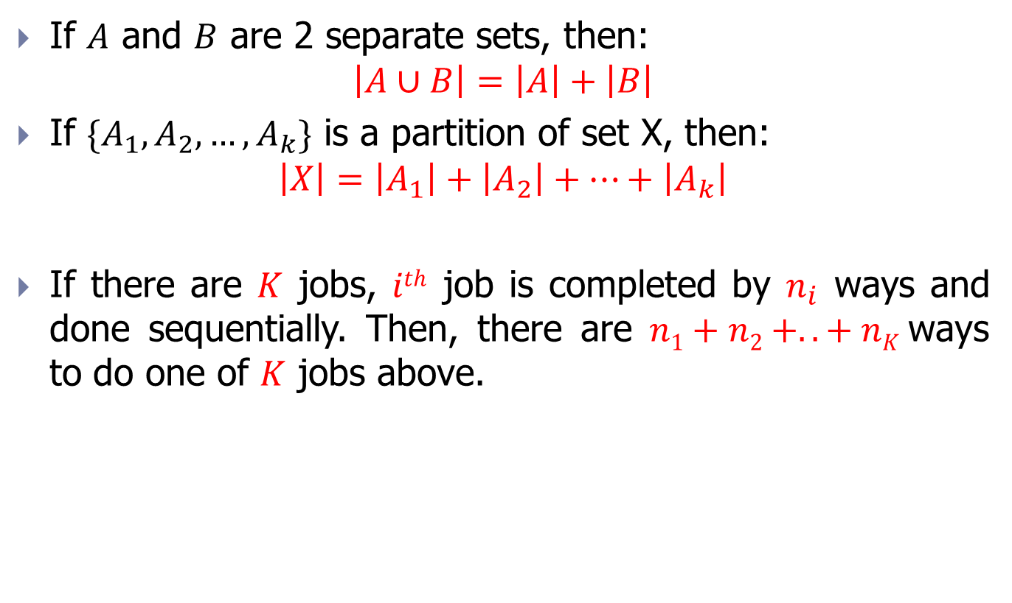
Sum rule (recall)
If $A$ and $B$ are 2 separate sets, then:
$$\left|A∪B\right|=\left|A\right|+\left|B\right|$$
If ${\{A}_{1},A_{2}, …,A_{k}\}$ is a partition of set X, then:
$$\left|X\right|=\left|A_{1}\right|+\left|A_{2}\right|+…+\left|A_{k}\right|$$
If there are $K$ jobs, $ith$ job is completed by $n_{i}$ ways and done sequentially. Then, there are $n1+n2 +..+ nK$ways to do one of $K$ jobs above.

Slide 7
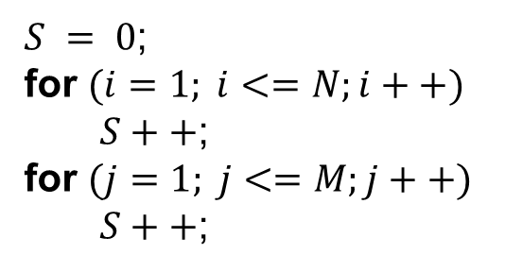

Example 1
Problem: Assume $N, M$are 2 definite natural number. Give the value of $S$ after executing the program below:
$S = 0$;
for $(i=1; i<=N;i++)$
$S++$;
for $(j=1; j<=M;j++)$
$S++$;

Slide 8
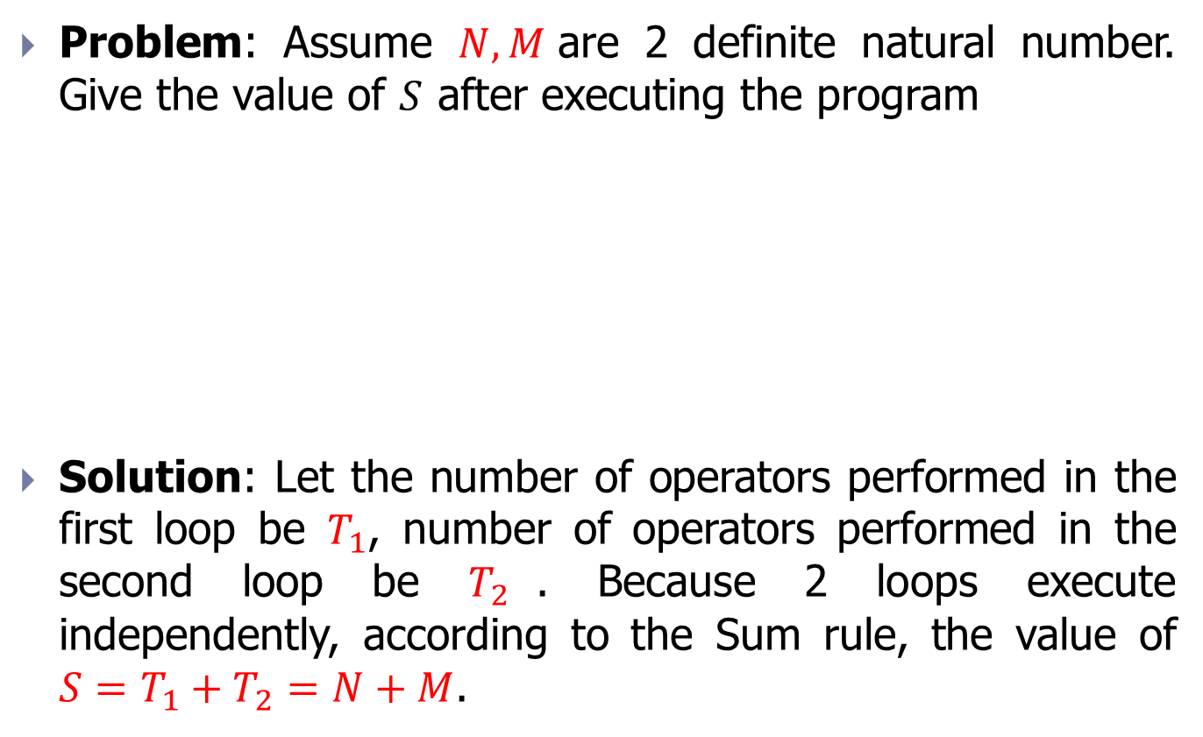
Example 1
Problem: Assume $N, M$are 2 definite natural number. Give the value of $S$ after executing the program
Solution: Let the number of operators performed in the first loop be $T_{1}$, number of operators performed in the second loop be $T_{2}$. Because 2 loops execute independently, according to the Sum rule, the value of $S=T_{1}+T_{2}=N+M$.
$S = 0$;
for $(i=1; i<=N;i++)$
$S++$;
for $(j=1; j<=M;j++)$
$S++$;

Slide 9
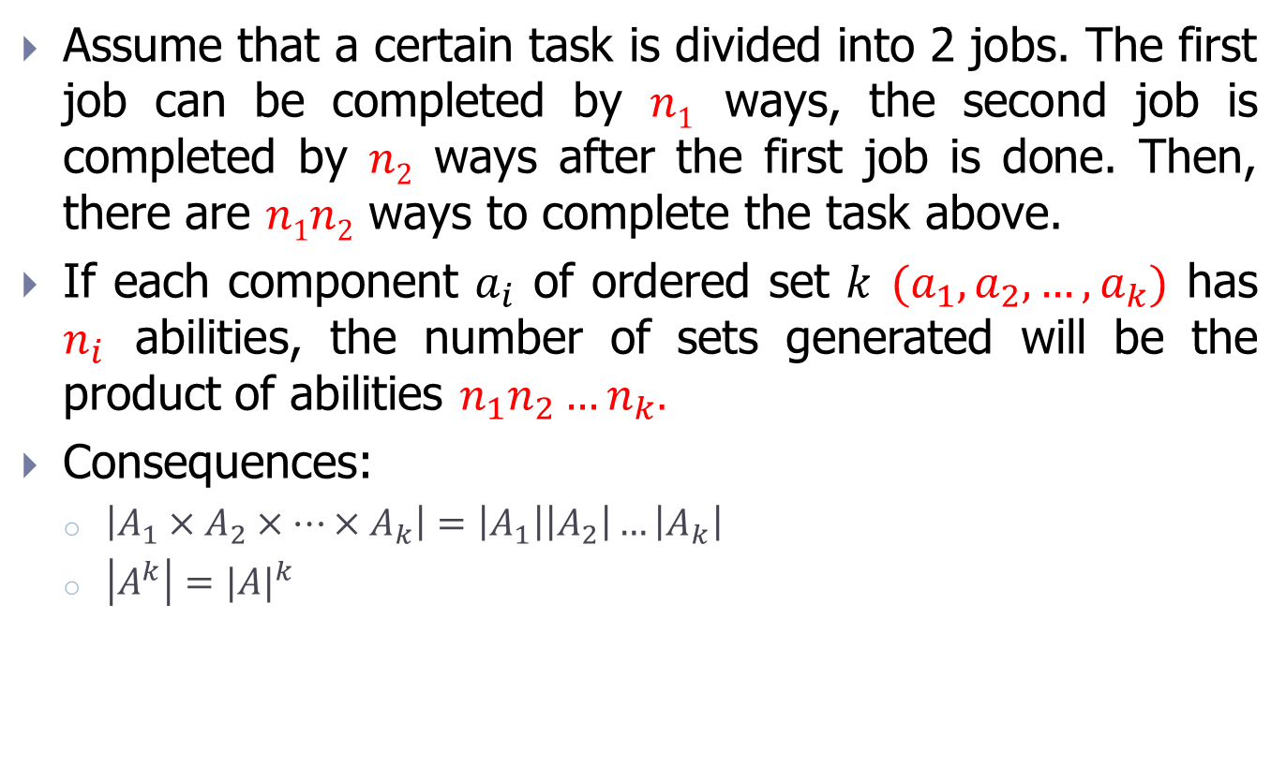
Product rule (recall)
Assume that a certain task is divided into 2 jobs. The first job can be completed by $n1$ ways, the second job is completed by $n2$ ways after the first job is done. Then, there are $n1n2$ ways to complete the task above.
If each component $a_{i}$ of ordered set $k$ $(a_{1},a_{2},…,a_{k})$ has $n_{i}$ abilities, the number of sets generated will be the product of abilities $n_{1}n_{2}…n_{k}.$
Consequences:
$\left|A_{1}×A_{2}×…×A_{k}\right|=\left|A_{1}\right|\left|A_{2}\right|…\left|A_{k}\right|$
$\left|A^{k}\right|={|A|}^{k}$

Slide 10
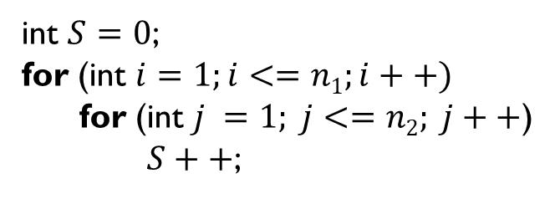

Example 2
Problem: Assume$n1, n2$are 2 definite natural number. Give the value of $S$ after executing the program below:
int $S=0$;
for (int $i=1;i<=n1;i++)$
for (int $j =1; j<=n2; j++$)
$S++$;

Slide 11
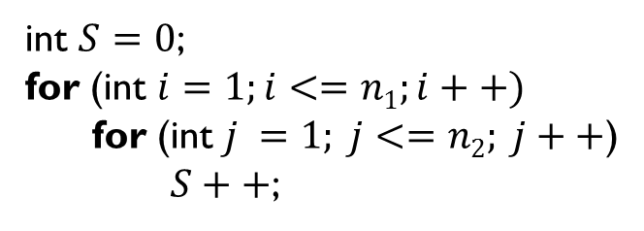
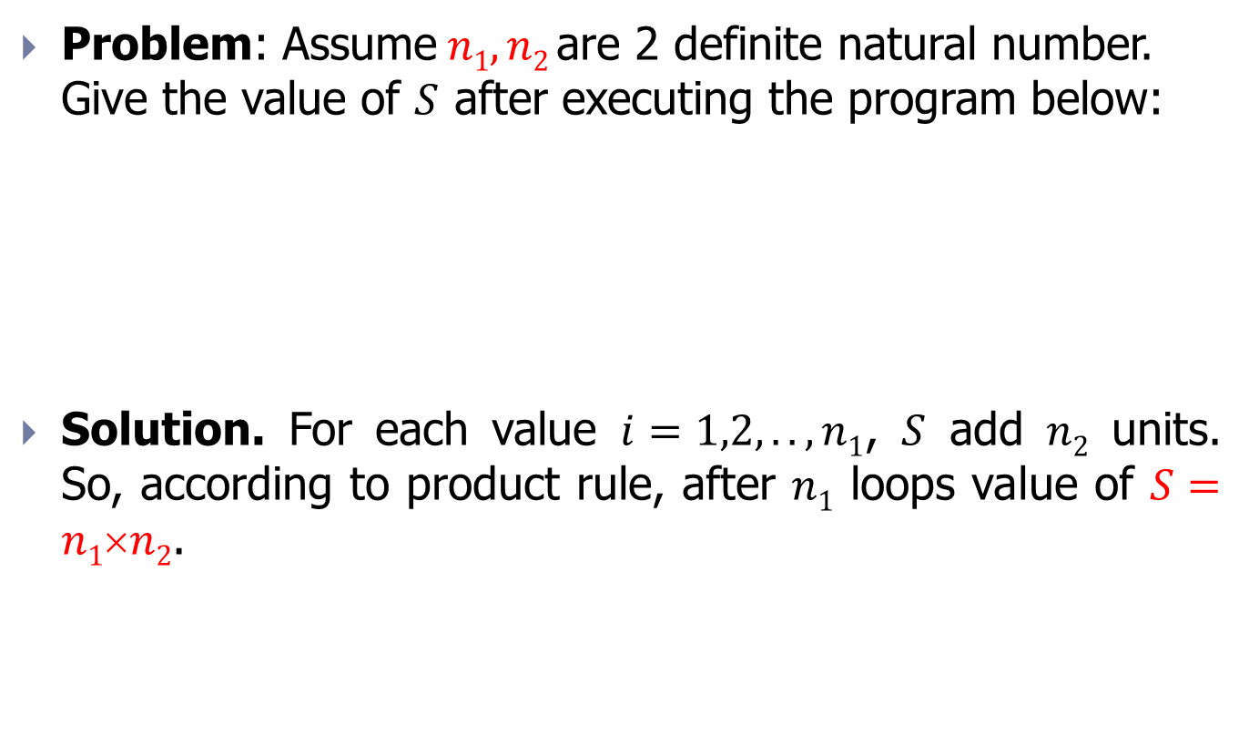
Example 2
Problem: Assume$n1, n2$are 2 definite natural number. Give the value of $S$ after executing the program below:
Solution. For each value $i=1,2,..,n1$, $S$ add $n2$ units. So, according to product rule, after $n1$ loops value of $S=n1n2$.
int $S=0$;
for (int $i=1;i<=n1;i++)$
for (int $j =1; j<=n2; j++$)
$S++$;

Slide 12
Example 3
Problem: How many 5-digit positive integers which do not contain the digit 1 and no any 2 digits are the same?

Slide 13
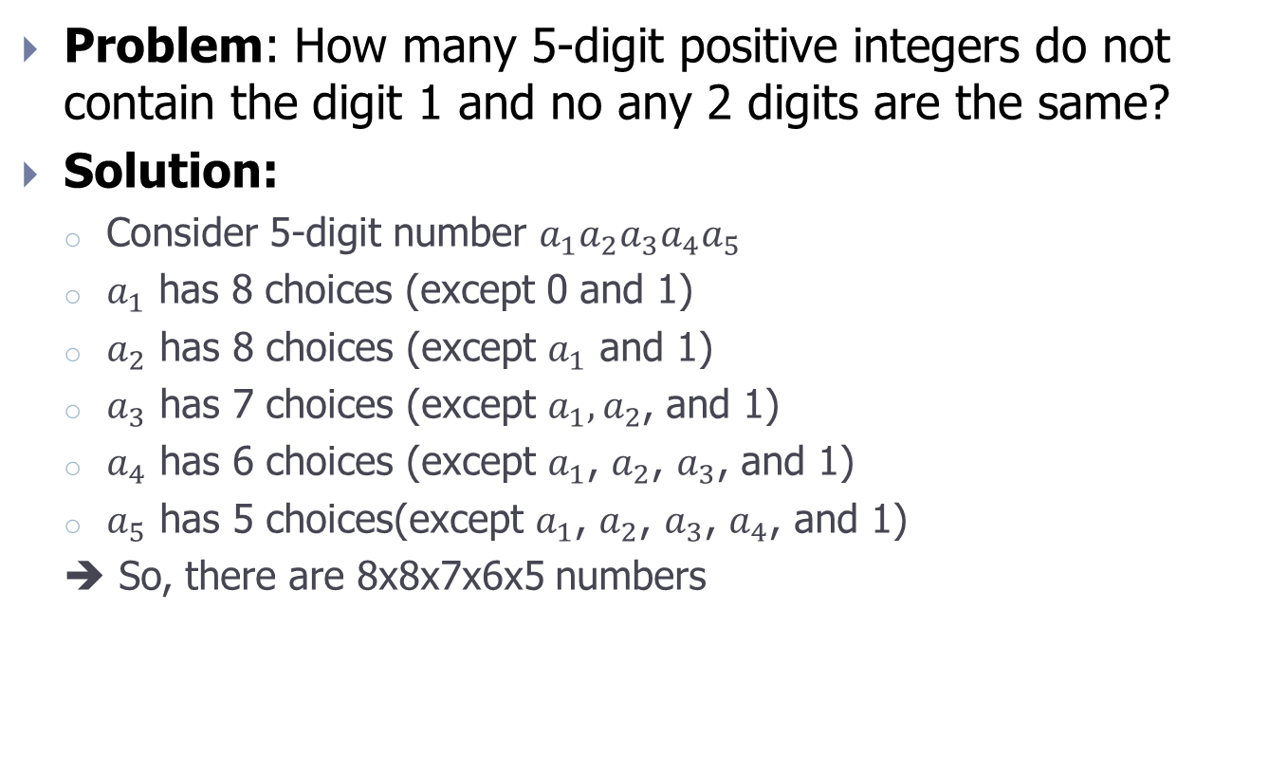
Example 3
Problem: How many 5-digit positive integers do not contain the digit 1 and no any 2 digits are the same?
Solution:
Consider 5-digit number $a_{1}a_{2}a_{3}a_{4}a_{5}$
$a_{1}$ has 8 choices (except 0 and 1)
$a_{2}$ has 8 choices (except $a_{1}$ and 1)
$a_{3}$ has 7 choices (except $a_{1},a_{2}$, and 1)
$a_{4}$ has 6 choices (except $a_{1}$, $a_{2}$, $a_{3}$, and 1)
$a_{5}$ has 5 choices(except $a_{1}$, $a_{2}$, $a_{3}$, $a_{4}$, and 1)
➔ So, there are 8x8x7x6x5 numbers

Slide 14
Example 4
Problem: How many variable names in C programming language of length 8, contain only 2 letters ‘a’ and ‘b’ and start with ‘aaa’ or ‘bbb’?

Slide 15
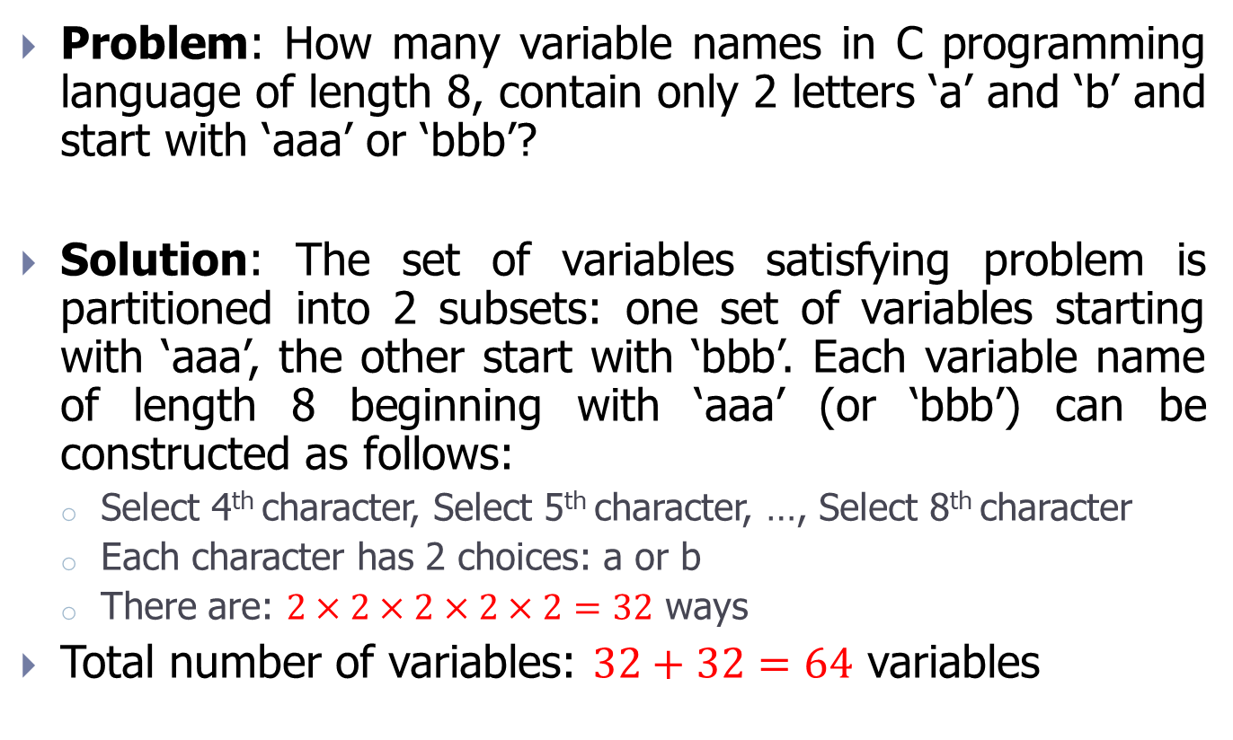
Example 4
Problem: How many variable names in C programming language of length 8, contain only 2 letters ‘a’ and ‘b’ and start with ‘aaa’ or ‘bbb’?
Solution: The set of variables satisfying problem is partitioned into 2 subsets: one set of variables starting with ‘aaa’, the other start with ‘bbb’. Each variable name of length 8 beginning with ‘aaa’ (or ‘bbb’) can be constructed as follows:
Select 4th character, Select 5th character, …, Select 8th character
Each character has 2 choices: a or b
There are: $2×2×2×2×2=32$ ways
Total number of variables: $32+32=64$ variables

Slide 16
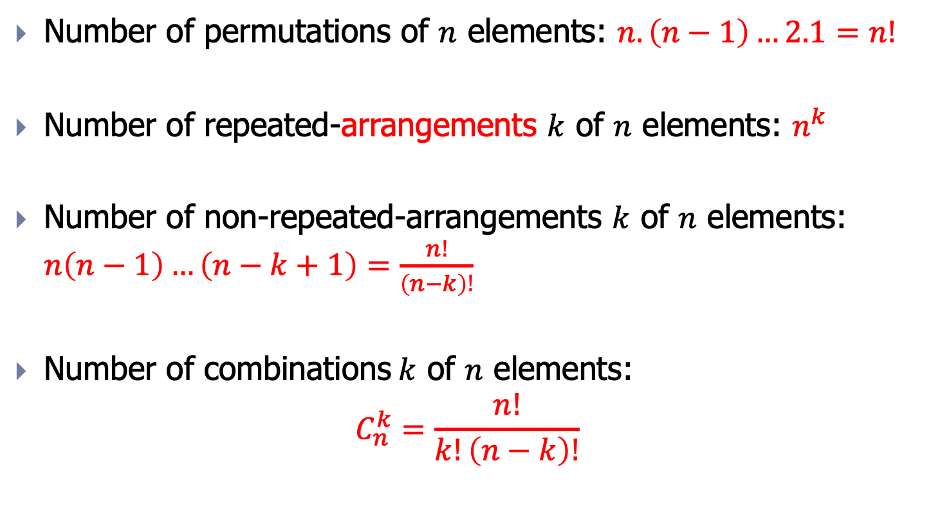
Permutation, Arrangement, Combination (recall)
Number of permutations of $n$ elements: $n.\left(n−1\right)…2.1=n!$
Number of repeated-arrangements $k$ of $n$ elements: $n^{k}$
Number of non-repeated-arrangements $k$ of $n$ elements: $n\left(n−1\right)…\left(n−k+1\right)=\frac{n!}{\left(n−k\right)!}$
Number of combinations$k$ of $n$ elements:
$$C_{n}^{k}=\frac{n!}{k!\left(n−k\right)!}$$
Notes:
Xem lại từ arrangements

Slide 17

Example 5
Problem: How many non-negative integer roots does the equation $x_{1}+x_{2}+x_{3}=11$have?

Slide 18
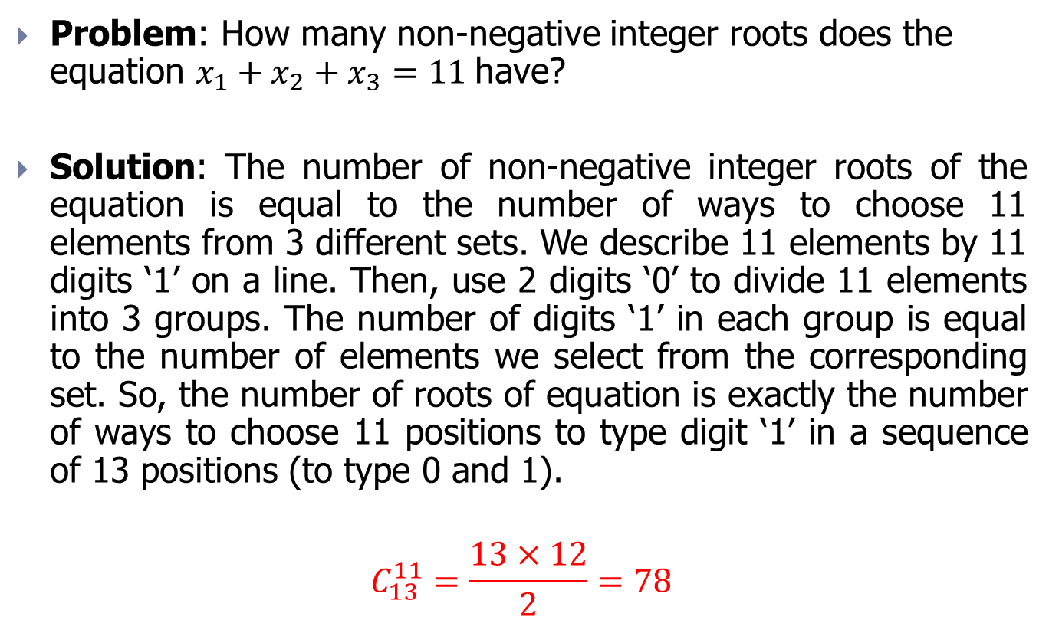
Example 5
Problem: How many non-negative integer roots does the equation $x_{1}+x_{2}+x_{3}=11$have?
Solution: The number of non-negative integer roots of the equation is equal to the number of ways to choose 11 elements from 3 different sets. We describe 11 elements by 11 digits ‘1’ on a line. Then, use 2 digits ‘0’ to divide 11 elements into 3 groups. The number of digits ‘1’ in each group is equal to the number of elements we select from the corresponding set. So, the number of roots of equation is exactly the number of ways to choose 11 positions to type digit ‘1’ in a sequence of 13 positions (to type 0 and 1).
$$C_{13}^{11}=\frac{13×12}{2}=78$$

Slide 19

Example 6
Problem: How many non-negative integer roots does the equation${ x}_{1}+x_{2}+…+x_{n}=k$ have?

Slide 20
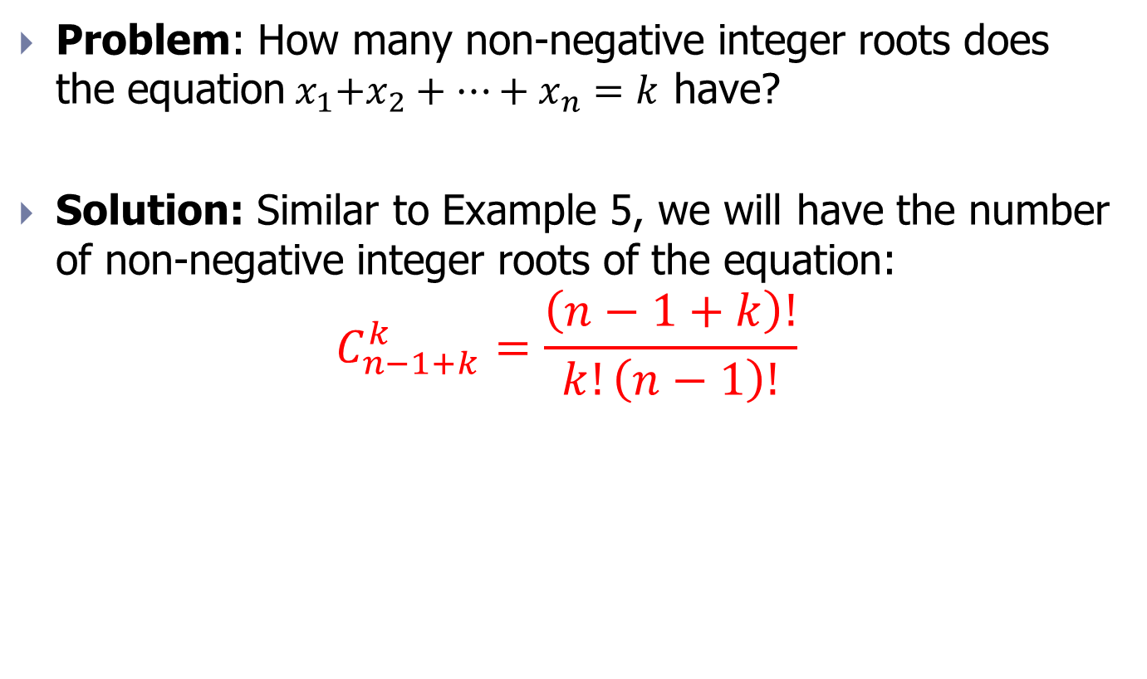
Example 6
Problem: How many non-negative integer roots does the equation${ x}_{1}+x_{2}+…+x_{n}=k$ have?
Solution: Similar to Example 5, we will have the number of non-negative integer roots of the equation:
$$C_{n−1+k}^{k}=\frac{\left(n−1+k\right)!}{k!\left(n−1\right)!}$$

Slide 21

Example 7
Problem: How many non-negative integer roots that satisfy condition $x_{1}1, x_{2}2, x_{3}3$ does the equation $x_{1}+x_{2}+x_{3}=11$have?

Slide 22
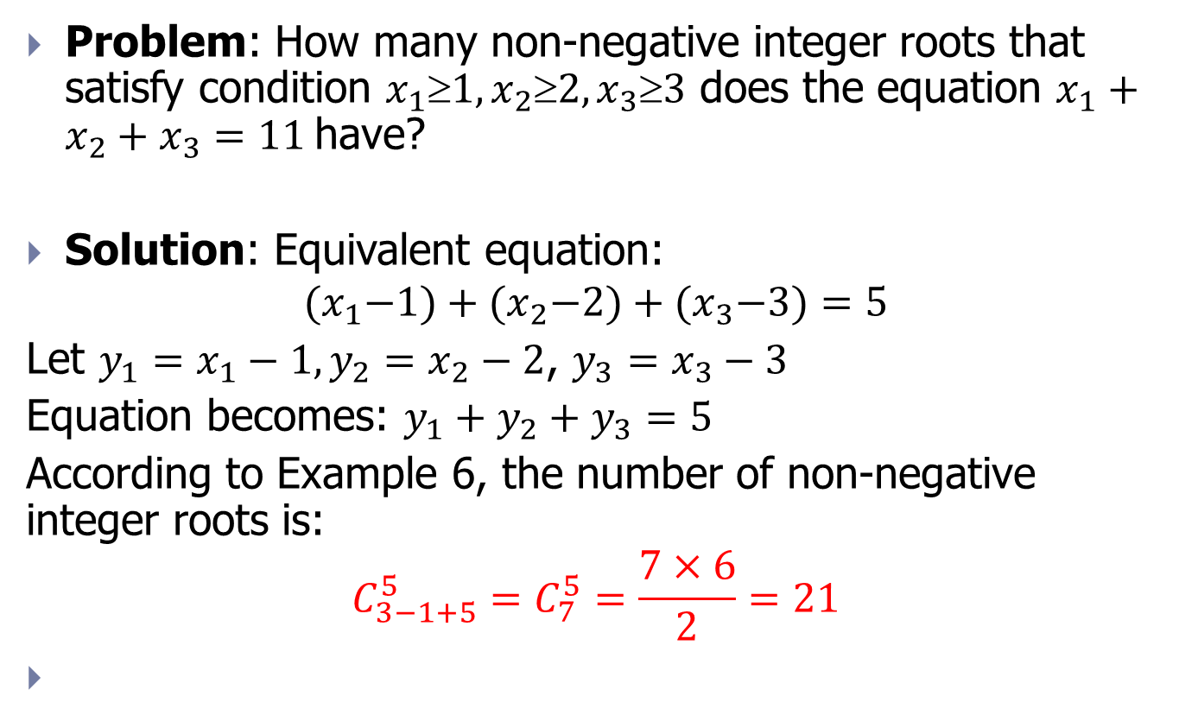
Example 7
Problem: How many non-negative integer roots that satisfy condition $x_{1}1, x_{2}2, x_{3}3$ does the equation $x_{1}+x_{2}+x_{3}=11$have?
Solution: Equivalent equation:
$${(x}_{1}−1)+{(x}_{2}−2)+{(x}_{3}−3)=5$$
Let $y_{1}=x_{1}−1,y_{2}=x_{2}−2$, $y_{3}=x_{3}−3$
Equation becomes: $y_{1}+y_{2}+y_{3}=5$
According to Example 6, the number of non-negative integer roots is:
$$C_{3−1+5}^{5}=C_{7}^{5}=\frac{7×6}{2}=21$$

Slide 23

Example 8
Problem: How many non-negative integer roots that satisfy condition $x_{1}≥m_{1}, …,x_{n}≥m_{n}$does the equation${ x}_{1}+x_{2}+…+x_{n}=k$ have?

Slide 24
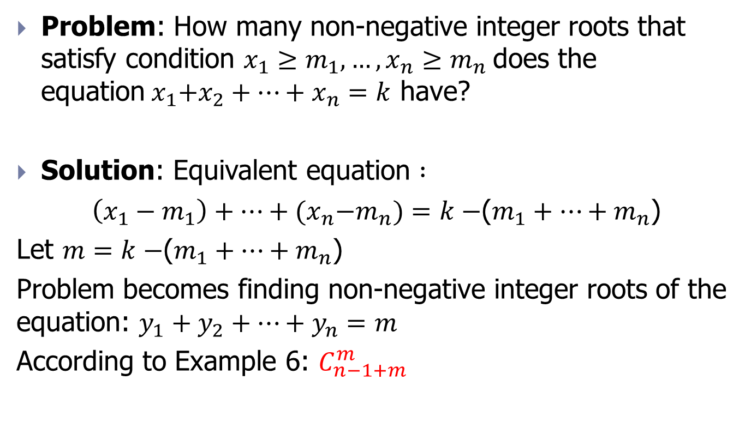
Example 8
Problem: How many non-negative integer roots that satisfy condition $x_{1}≥m_{1}, …,x_{n}≥m_{n}$does the equation${ x}_{1}+x_{2}+…+x_{n}=k$ have?
Solution: Equivalent equation $:$
$\left(x_{1}−m_{1}\right)+…+{(x}_{n}−m_{n})=k−$($m_{1}+…+m_{n}$)
Let $m=k−$($m_{1}+…+m_{n}$)
Problem becomes finding non-negative integer roots of the equation: $y_{1}+y_{2}+…+y_{n}=m$
According to Example 6: $C_{n−1+m}^{m}$

Slide 25
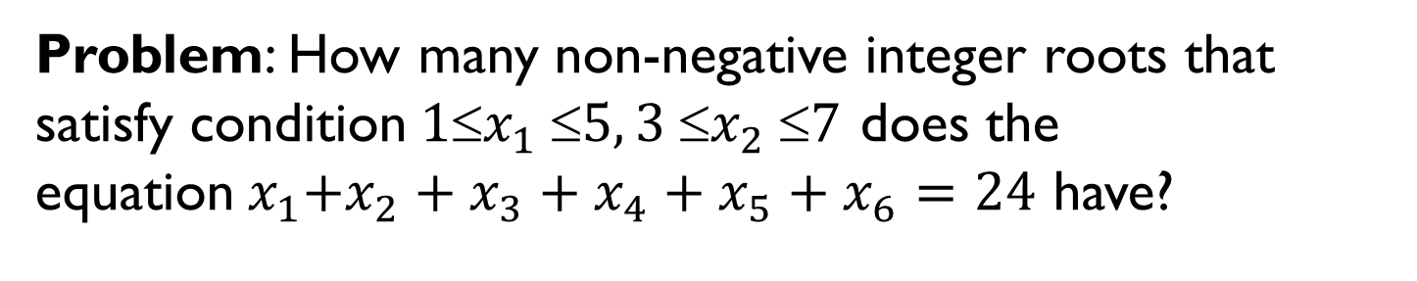
Example 9
Problem: How many non-negative integer roots that satisfy condition$1x_{1} 5, 3 x_{2} 7$ does the equation${ x}_{1}+x_{2}+x_{3}+x_{4}+x_{5}+x_{6}=24$ have?

Slide 26
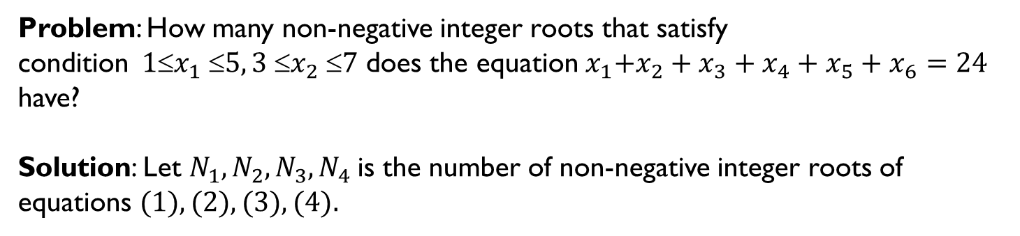
Example 9
Problem: How many non-negative integer roots that satisfy condition$1x_{1} 5, 3 x_{2} 7$ does the equation${ x}_{1}+x_{2}+x_{3}+x_{4}+x_{5}+x_{6}=24$ have?
Solution: Let $N_{1},N_{2},N_{3},N_{4}$is the number of non-negative integer roots of equations $(1), (2), (3), (4).$
(1)
(2)
(3)
(4)

Slide 27
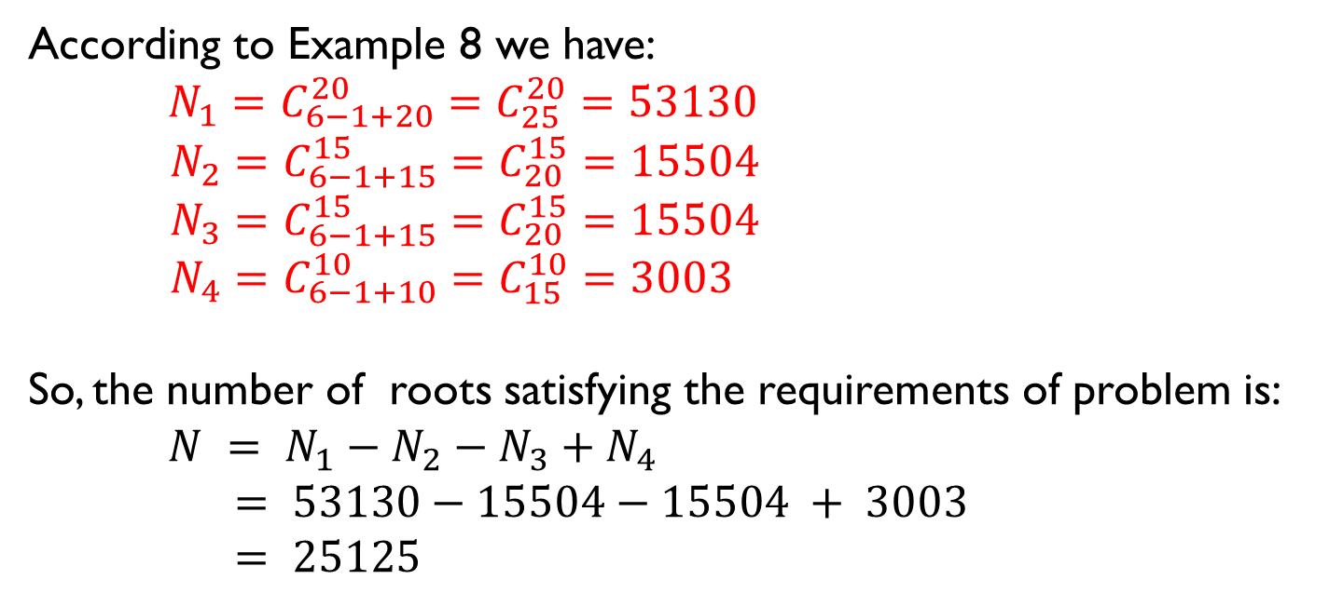
Example 9
According to Example 8 we have:
$N_{1}=C_{6−1+20}^{20}=C_{25}^{20}=53130$
$N_{2}=C_{6−1+15}^{15}=C_{20}^{15}=\text{15504}$
$N_{3}=C_{6−1+15}^{15}=C_{20}^{15}=\text{15504}$
$N_{4}=C_{6−1+10}^{10}=C_{15}^{10}=\text{3003}$
So, the number of roots satisfying the requirements of problem is:
$N = N_{1}−N_{2}−N_{3}+N_{4}$
$= 53130−15504−15504 + 3003$
$= 25125$

Slide 28
Exercise 1
In each lottery release, each lottery ticket have 2 parts. The letter part includes 2 letters with values from A to Z. The number part includes 4 numbers with values from 0 to 9. Each lottery release has 1 special prize, 2 first prizes, 5 second prizes and 10 third prizes. Calculate the probability that a lottery ticket wins a prize or more in following 2 cases:
The letter part stand before the number part.
The letter part stand arbitrarily.

Slide 29
Exercise 2
Calculate the number of matches at each World Cup.

Slide 30




Exercise 3
Give the grid as below. We index the columns from 0 to m (from left to right) and rows from 0 to n (form bottom to top). How many ways are there to move from position (0,0) to position (n, m) if we only move along the edges of the cells from left to right and from bottom to top.
$$(n,0)$$
$$(n,m)$$
$$(0,0)$$
$$(0,m)$$

Slide 31
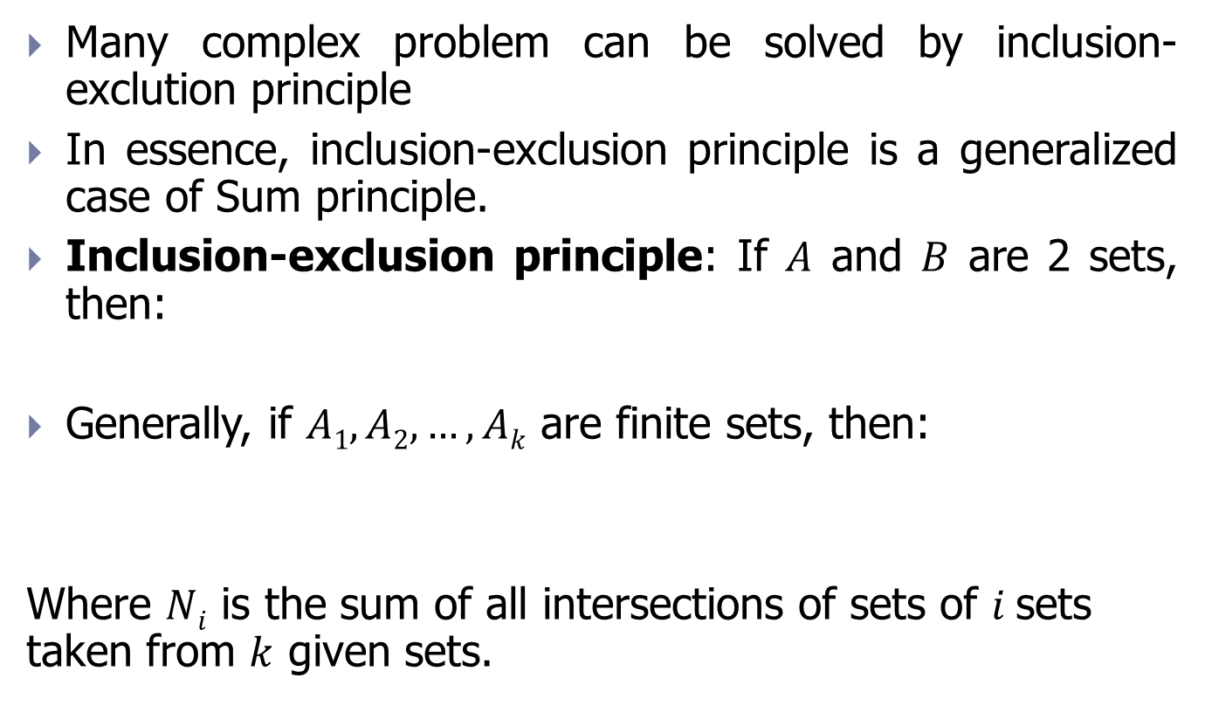
Inclusion-Exclusion principle
Many complex problem can be solved by inclusion-exclution principle
In essence, inclusion-exclusion principle is a generalized case of Sum principle.
Inclusion-exclusion principle: If $A$ and $B$ are 2 sets, then:
Generally, if $A1, A2, …, Ak$ are finite sets, then:
Where $Ni$ is the sum of all intersections of sets of $i$sets taken from $k$ given sets.

Slide 32

Example 10
Problem: In set $X=\{1,2,…,10000\}$ how many numbers are not divisible by any of the numbers 3, 4, 7?

Slide 33
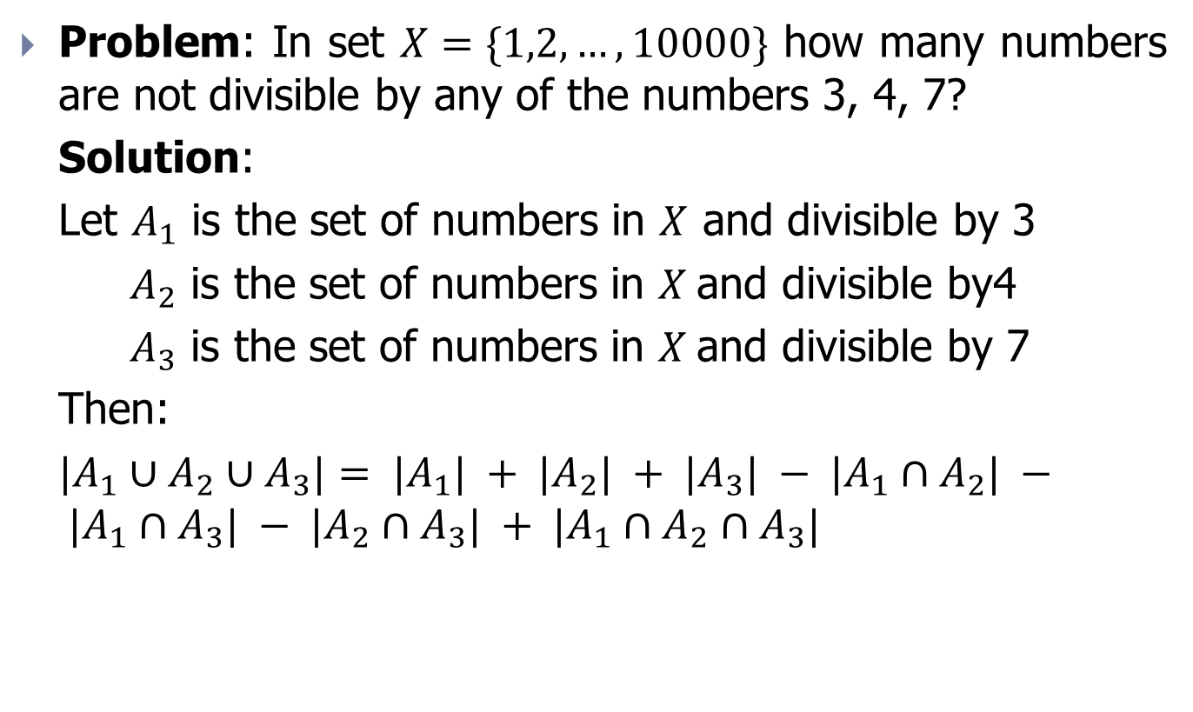
Example 10
Problem: In set $X=\{1,2,…,10000\}$ how many numbers are not divisible by any of the numbers 3, 4, 7?
Solution:
Let $A_{1}$ is the set of numbers in $X$ and divisible by 3
${ A}_{2}$ is the set of numbers in $X$and divisible by4
${ A}_{3}$ is the set of numbers in $X$and divisible by 7
Then:
$|A_{1}∪A_{2}∪A_{3}|= |A_{1}| + |A_{2}| + |A_{3}| − |A_{1}∩A_{2}| − |A_{1}∩A_{3}| − |A_{2}∩A_{3}| + |A_{1}∩A_{2}∩A_{3}|$

Slide 34
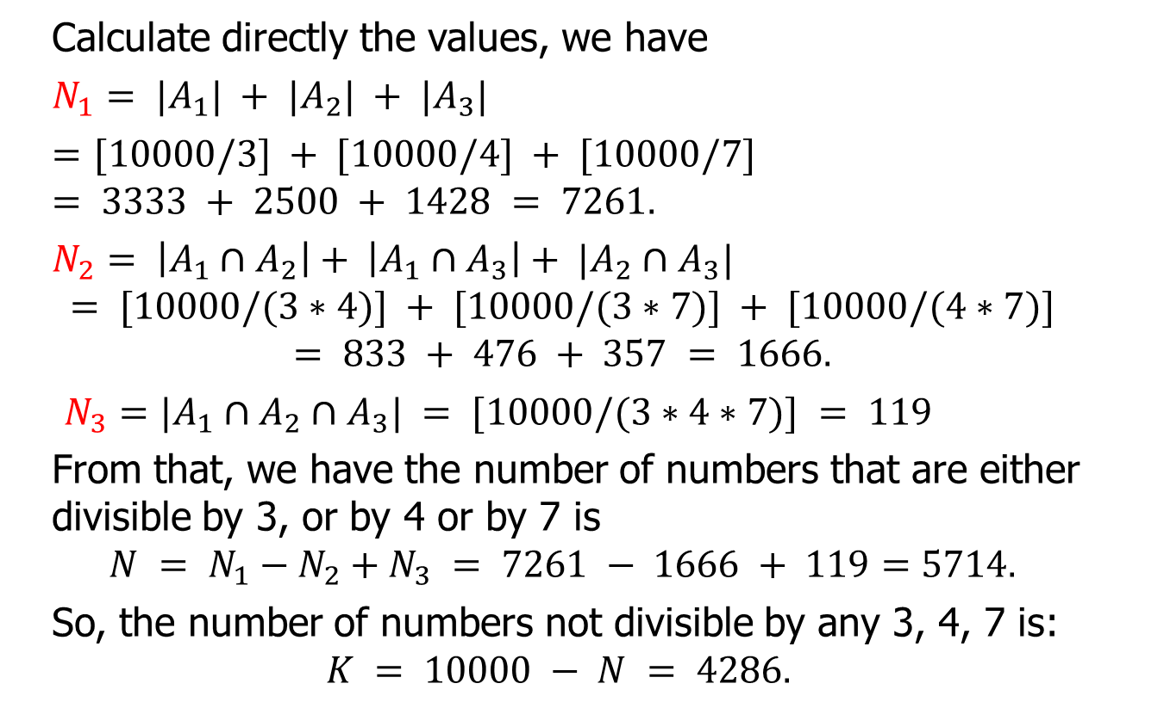
Example 10
Calculate directly the values, we have
$N_{1}= |A_{1}| + |A_{2}| + |A_{3}|$
$=$ $[10000/3] + [10000/4] + [10000/7]$ $= 3333 + 2500 + 1428 = 7261.$
$N_{2}= \left|A_{1}∩A_{2}\right|+ \left|A_{1}∩A_{3}\right|+ |A_{2}∩A_{3}|$
$$= [10000/(3∗4)] + [10000/(3∗7)] + [10000/(4∗7)]$$
$$= 833 + 476 + 357 = 1666.$$
$N_{3}=|A_{1}∩A_{2}∩A_{3}| = [10000/(3∗4∗7)] = 119$
From that, we have the number of numbers that are either divisible by 3, or by 4 or by 7 is
$$N = N_{1}−N_{2}+N_{3} = 7261 − 1666 + 119=5714.$$
So, the number of numbers not divisible by any 3, 4, 7 is:
$$K = 10000 − N = 4286.$$

Slide 35
Example 11
Problem: Given that there are 1232 students studying Spanish, 879 students stydying French and 114 students studying Russian, 103 students studying both Spanish and French, 23 students studying Spanish and Russian, 14 students studying both French and Russian. If all 2092 students study at least 1 foreign language, how many students study all 3 languages?

Slide 36
Example 12
Letter problem:There are n letters put in n pre-addressed envelops. Randomly put letters into envelops. What is the probability that none of the letters get to the correct address?

Slide 37
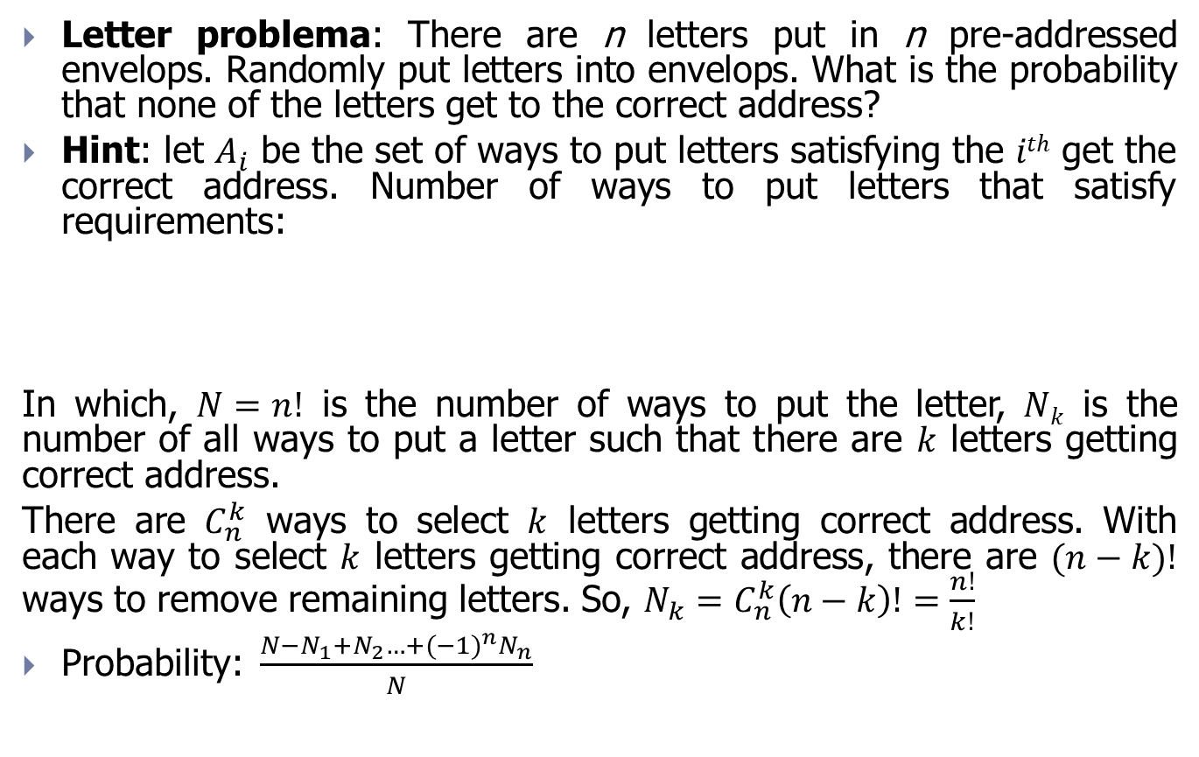
Example 12
Letter problema: There are n letters put in n pre-addressed envelops. Randomly put letters into envelops. What is the probability that none of the letters get to the correct address?
Hint: let $A_{i}$ be the set of ways to put letters satisfying the $ith$ get the correct address. Number of ways to put letters that satisfy requirements:
In which, $N=n!$ is the number of ways to put the letter, $Nk$ is the number of all ways to put a letter such that there are $k$ letters getting correct address.
There are $C_{n}^{k}$ ways to select $k$ letters getting correct address. With each way to select $k$ letters getting correct address, there are $(n−k)!$ ways to remove remaining letters. So, $N_{k}=C_{n}^{k}\left(n−k\right)!=\frac{n!}{k!}$
Probability:$\frac{N−N_{1}+N_{2}…+{(−1)}^{n}N_{n}}{N}$

Slide 38
Exercise 1
How many ways are there to arrange 5 people A, B, C, D, E in a horizontal row so that A is not next to B?

Slide 39
Exercise 2
Calculate the number of 5-digit numbers so that at least 2 digits are the same?

Slide 40
Contents
Introduction
Basic counting principle
Conquer the the subproblem
Recurrence relations
Generating function method
Exercise

Slide 41
Conquer the the subproblem
Another method to solve counting problem is returning simple subproblems
This is not always easy because we need to deeply analyze the configurations to count.

Slide 42
Example 13
Problem: Among 7-digit natural numbers, count the number of reversable numbers (symmetric numbers) whose sum of digits is 18?

Slide 43
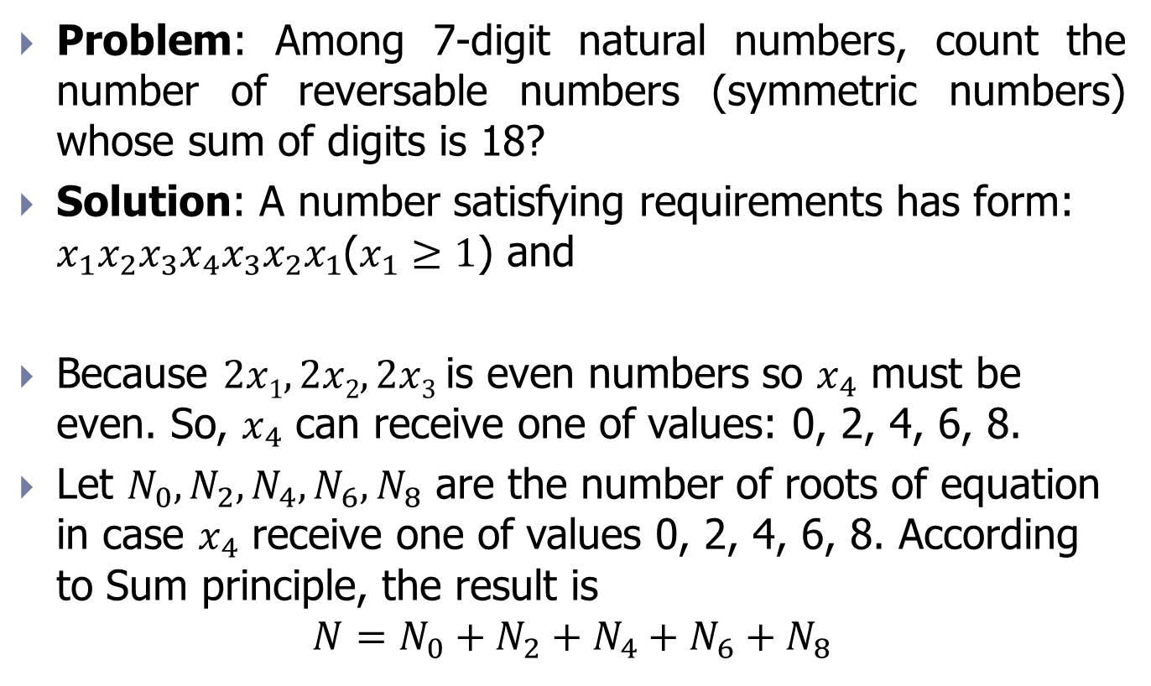
Example 13
Problem: Among 7-digit natural numbers, count the number of reversable numbers (symmetric numbers) whose sum of digits is 18?
Solution: A number satisfying requirements has form: $x_{1}x_{2}x_{3}x_{4}x_{3}x_{2}x_{1}$($x_{1}≥1$) and
Because $2x1, 2x2, 2x3$is even numbers so $x_{4}$ must be even. So, $x_{4}$ can receive one of values: 0, 2, 4, 6, 8.
Let $N_{0}, N_{2}, N_{4}, N_{6},N_{8}$ are the number of roots of equation in case $x_{4}$ receive one of values 0, 2, 4, 6, 8. According to Sum principle, the result is
$$N=N_{0}+N_{2}+N_{4}+N_{6}+N_{8}$$

Slide 44

Example 13
We have $N_{0}, N_{2}, N_{4}, N_{6},N_{8}$ are the number of roots of following equation:
These subproblems can be solved easily according to Example 8

Slide 45
Contents
Introduction
Basic counting principle
Conquer the the subproblem
Recurrence relations
Generating function method
Exercise

Slide 46
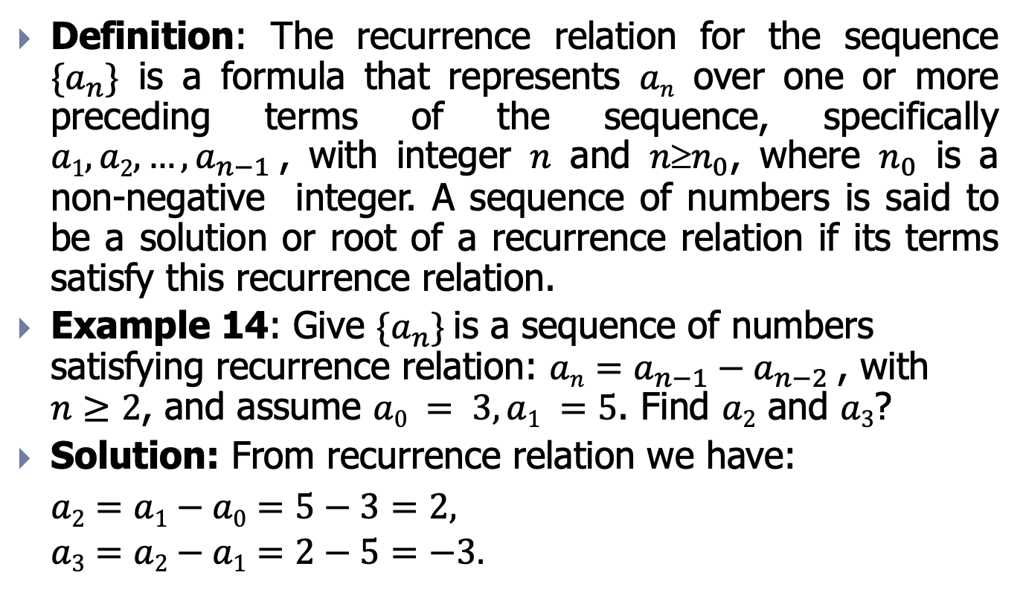
Recurrence relations
Definition: The recurrence relation for the sequence $\{a_{n}\}$ is a formula that represents $an$ over one or more preceding terms of the sequence, specifically $a1, a2,…,a_{n−1}$, with integer $n$ and $nn_{0}$, where $n_{0}$ is a non-negative integer. A sequence of numbers is said to be a solution or root of a recurrence relation if its terms satisfy this recurrence relation.
Example 14: Give $\{a_{n}\}$is a sequence of numbers satisfying recurrence relation: $an=a_{n−1}−a_{n−2}$, with $n≥2$, and assume $a0 = 3, a1 =5$. Find $a2$ and $a3$?
Solution: From recurrence relation we have:
$a2=a1−a0=5−3=2,$
$$a3=a2−a1=2−5=−3.$$

Slide 47
Modeling the recurrence relation
Using the recurrence relation, we can model very broad classes in reality. Each specific problem has a different modeling method. Here are some typica examples.
Example 15: Population problem. Assume that in 1995, the world population was 7 billion. Every year, the world’s population increases by 3%. By 2020, what is the world population?

Slide 48
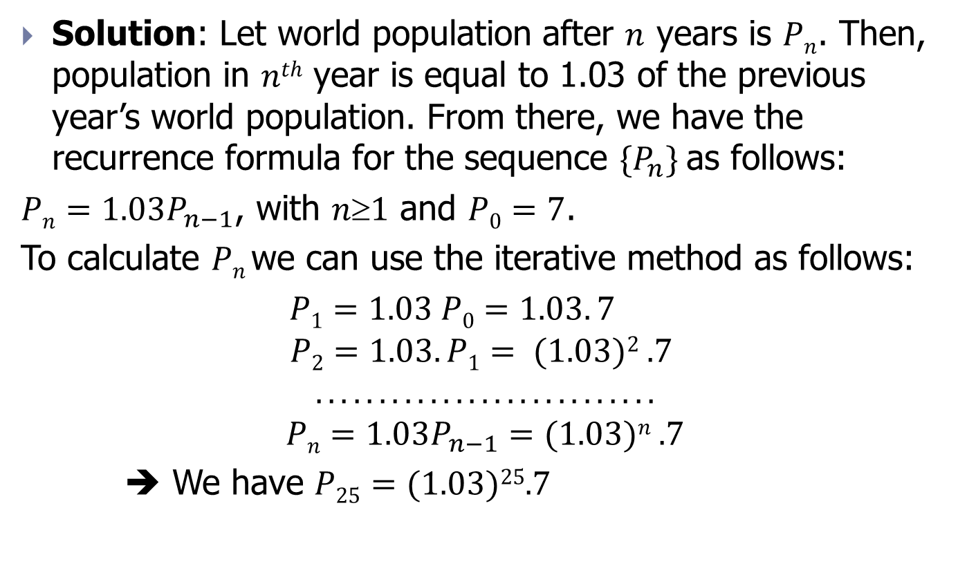
Example 15
Solution: Let world population after $n$ years is $Pn$. Then, population in $nth$ year is equal to 1.03 of the previous year’s world population. From there, we have the recurrence formula for the sequence $\{P_{n}\}$as follows:
$Pn=1.03P_{n−1}$, with $n1$ and $P0=7$.
To calculate $Pn$we can use the iterative method as follows:
$P1=1.03 P0=1.03. 7$
$$P2=1.03.P1= (1.03)2 .7$$
$$. . . . . . . . . . . . . . . . . . . . . . . . . . .$$
$$Pn=1.03P_{n−1}=(1.03)n .7$$
➔ We have $P25=(1.03)25.7$

Slide 49

Example 16
Compound interest problem: A person deposits $X$ dollars in his account at a bank with a compound interest of $11\%$ per year. How much money does he have in his account after 30 years?

Slide 50
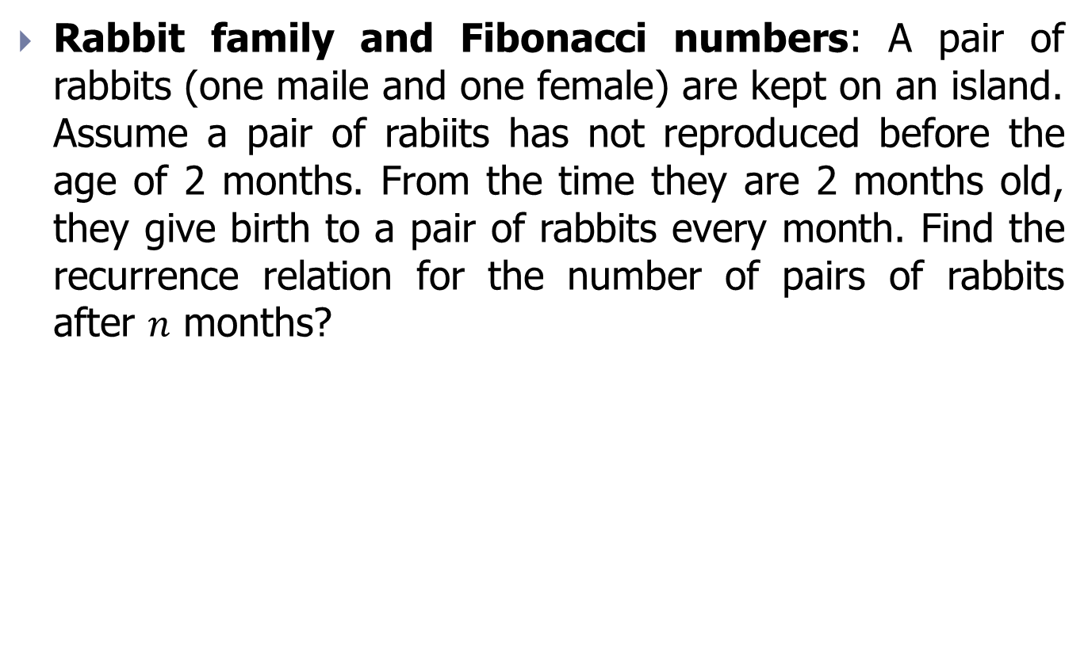
Example 17
Rabbit family and Fibonacci numbers: A pair of rabbits (one maile and one female) are kept on an island. Assume a pair of rabiits has not reproduced before the age of 2 months. From the time they are 2 months old, they give birth to a pair of rabbits every month. Find the recurrence relation for the number of pairs of rabbits after $n$ months?

Slide 51

Example 17
Solution: Let $f_{n}$ be the number of pairs of rabbits after $n$ months. We will show $f_{n}$ $(n=0,1, 2,…)$be exactly Fibonacci sequence of numbers?
Because after 2 months a pair of rabbits can breed, so the number of rabbits in the current month is equal to the number of rabbits in the previous month $f_{n−1}$ plus the number of new born rabbits $f_{n−2}$.
So, the sequence ${\{f}_{n}\}$ satisfy equation:
$f_{n}=f_{n−1}+f_{n−2}; n2$ with $f0=0, f1 =1.$
Số tháng | Số cặp sinh sản | Số cặp thỏ con | Tổng số cặp thỏ
1 | 0 | 1 | 1
2 | 0 | 1 | 1
3 | 1 | 1 | 2
4 | 1 | 2 | 3
5 | 2 | 3 | 5
6 | 3 | 5 | 8

Slide 52
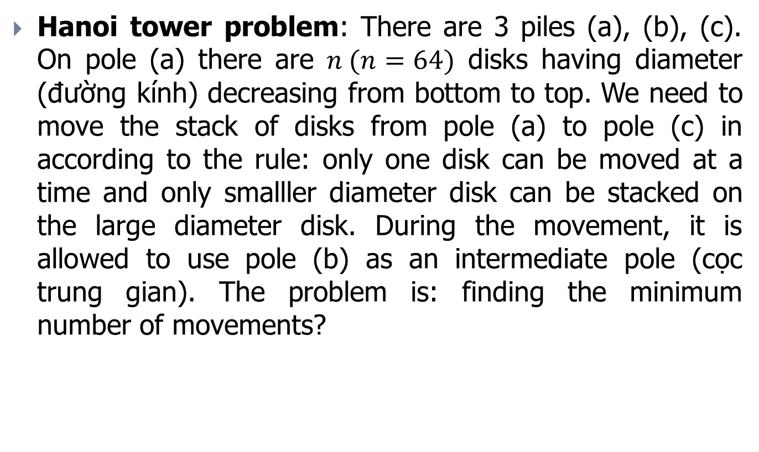
Example 18
Hanoi tower problem: There are 3 piles (a), (b), (c). On pole (a) there are $n (n=64)$ disks having diameter (đường kính) decreasing from bottom to top. We need to move the stack of disks from pole (a) to pole (c) in according to the rule: only one disk can be moved at a time and only smalller diameter disk can be stacked on the large diameter disk. During the movement, it is allowed to use pole (b) as an intermediate pole (cọc trung gian). The problem is: finding the minimum number of movements?

Slide 53
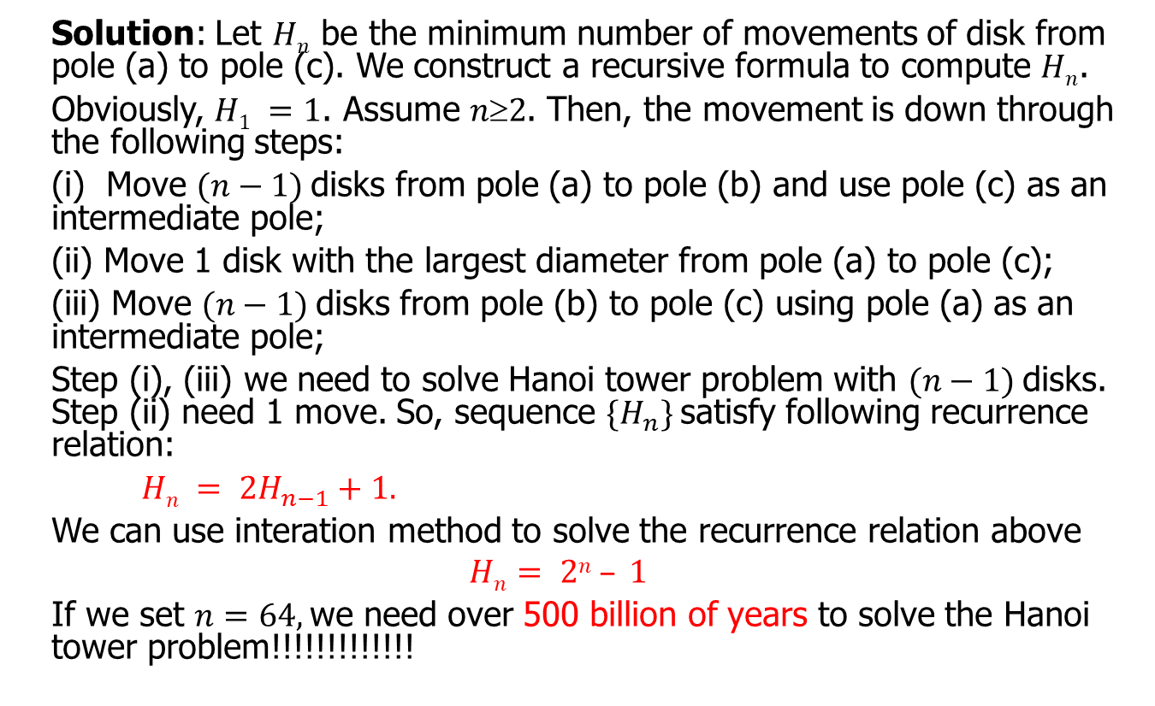
Example 18
Solution: Let $Hn$ be the minimum number of movements of disk from pole (a) to pole (c). We construct a recursive formula to compute $Hn$.
Obviously, $H1 =1$. Assume $n2$. Then, the movement is down through the following steps:
(i) Move $(n−1)$disks from pole (a) to pole (b) and use pole (c) as an intermediate pole;
(ii) Move 1 disk with the largest diameter from pole (a) to pole (c);
(iii) Move $(n−1)$disks from pole (b) to pole (c) using pole (a) as an intermediate pole;
Step (i), (iii) we need to solve Hanoi tower problem with $(n−1)$disks. Step (ii) need 1 move. So, sequence $\{H_{n}\}$satisfy following recurrence relation:
$Hn = 2H_{n−1}+1.$
We can use interation method to solve the recurrence relation above
$$Hn= 2n – 1$$
If we set $n=64,$we need over 500 billion of years to solve the Hanoi tower problem!!!!!!!!!!!!!

Slide 54

Example 19
Get $a_{n}$ is the number of binary strings with length of $n$, there are no 2 consecutive digit 0. Construct recurrence relation for $a_{n}$ and compute $a_{6}.$

Slide 55
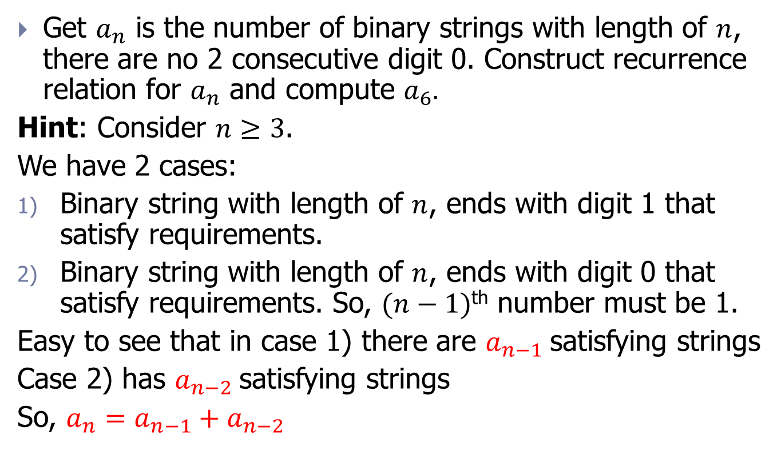
Example 19
Get $a_{n}$ is the number of binary strings with length of $n$, there are no 2 consecutive digit 0. Construct recurrence relation for $a_{n}$ and compute $a_{6}.$
Hint: Consider $n≥3$.
We have 2 cases:
Binary string with length of $n$, ends with digit 1 that satisfy requirements.
Binary string with length of $n$, ends with digit 0 that satisfy requirements. So, $(n−1)$^{th} number must be 1.
Easy to see that in case 1) there are $a_{n−1}$satisfying strings
Case 2) has $a_{n−2}$satisfying strings
So, $a_{n}=a_{n−1}+a_{n−2}$

Slide 56

Example 20
Calculate codewords: A computer sustem consideres a string of decimal digits as a valid codeword if it contains an even number of digit 0. For example, word 168304073 is valid, word 103203044 is invalid. Find the recurrence relation for valid codewords of length $n$?

Slide 57
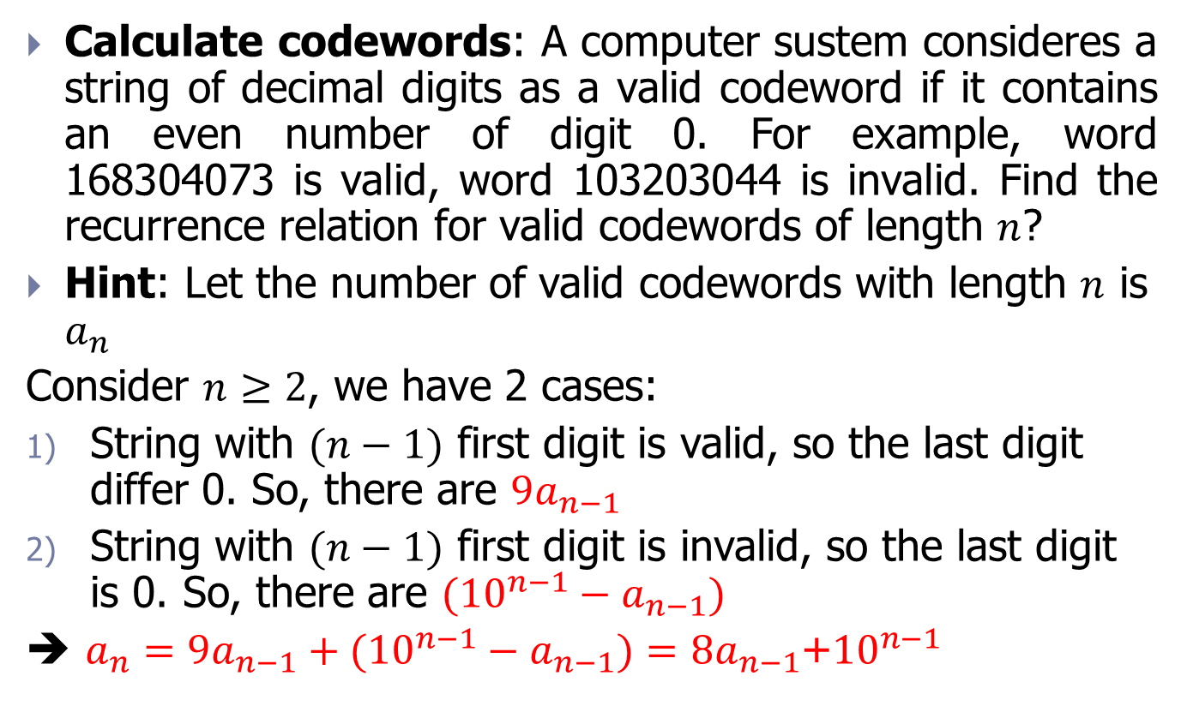
Example 20
Calculate codewords: A computer sustem consideres a string of decimal digits as a valid codeword if it contains an even number of digit 0. For example, word 168304073 is valid, word 103203044 is invalid. Find the recurrence relation for valid codewords of length $n$?
Hint: Let the number of valid codewords with length $n$ is $a_{n}$
Consider $n≥2$, we have 2 cases:
String with $(n−1)$ first digit is valid, so the last digit differ 0. So, there are ${9a}_{n−1}$
String with $(n−1)$ first digit is invalid, so the last digit is 0. So, there are ${({10}^{n−1}−a}_{n−1})$
➔ $a_{n}={9a}_{n−1}+{({10}^{n−1}−a}_{n−1})={8a}_{n−1}$+${10}^{n−1}$

Slide 58
Exercise
Find the recurrence relation and the initial condition to find the number of binary strings of length n that have at least one sequence of tow consecutive digit 0?
Find the recurrence relation and the initial condition to find the number of binary strings of length n that do not have any sequence of three consecutive digit 1?
Find the recurrence relation and the initial condition to find the number of binary strings of length n that do not have any sequence of four consecutive digit 1?
Find the recurrence relation and the initial condition to find the number of binary strings of length n that have at least one sequence of three consecutive digit 1?
Find the recurrence relation and the initial condition to find the number of binary strings of length n that have at least one sequence of four consecutive digit 1?
Find the recurrence relation and the initial condition to find the number of binary strings of length n that do not have any sequence of K consecutive digit 1?
Find the recurrence relation and the initial condition to find the number of binary strings of length n have at least one sequence of K consecutive digit 1?

Slide 59
Solve a recurrence relation by using the iteration method
Method: Iterate until meet the first condition in recurrence formulas.
Exercise: Find root of recurrence formula with following initial condition:
a_{n} = a_{n-1} + 2 with a₀ =3.
a_{n} = a_{n-1} + n with a₀ =1.
a_{n} = a_{n-1} + 2n + 3 with a₀ =4.
a_{n} = a_{n-1} + 2^{n} with a₀ =1.
a_{n} = a_{n-1} - 2n - 3 with a₀ =4.

Slide 60
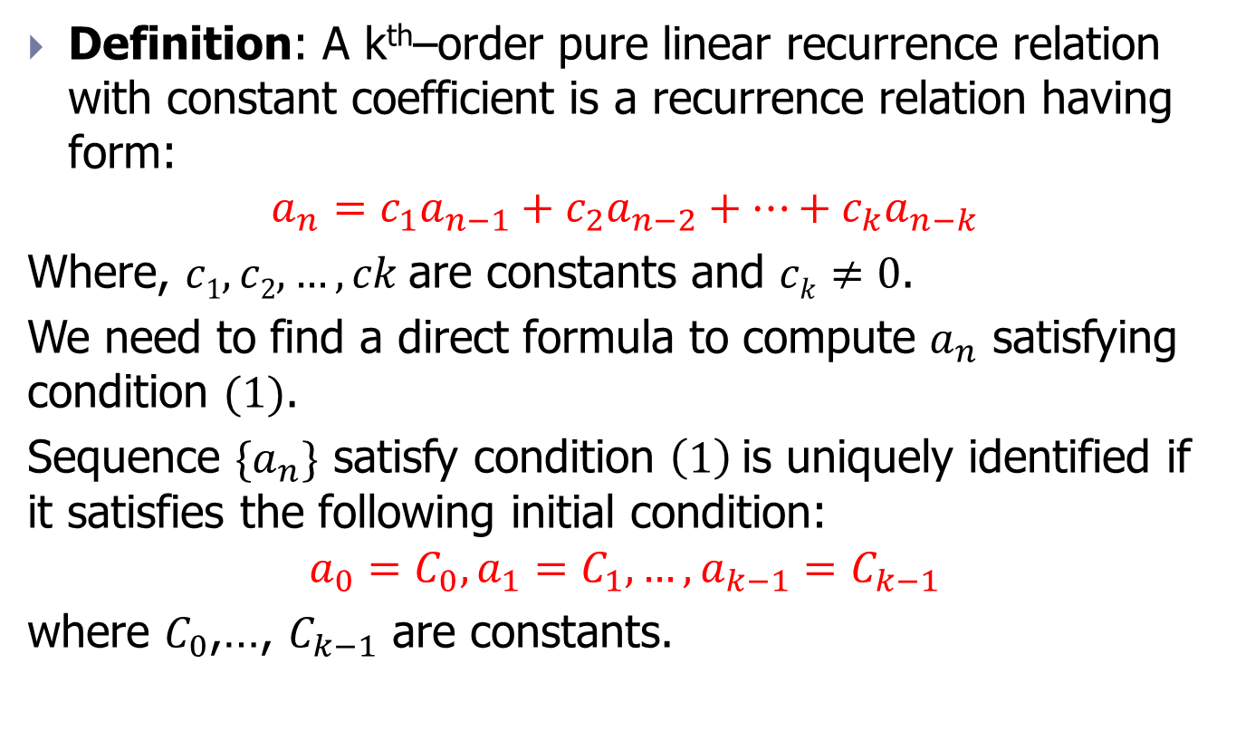


Pure linear recurrence relation
Definition: A k^{th}–order pure linear recurrence relation with constant coefficient is a recurrence relation having form:
$$a_{n}=c_{1}a_{n−1}+c_{2}a_{n−2}+…+c_{k}a_{n−k}$$
Where, $c1, c2,…,ck$are constants and $ck≠0$.
We need to find a direct formula to compute $a_{n}$ satisfying condition $(1)$.
Sequence ${\{a}_{n}\}$ satisfy condition $\left(1\right)$is uniquely identified if it satisfies the following initial condition:
$$a_{0}=C_{0}, a_{1}=C_{1},…,a_{k−1}=C_{k−1}$$
where $C_{0}$,…, $C_{k−1}$ are constants.
$$(1)$$
$$(2)$$

Slide 61
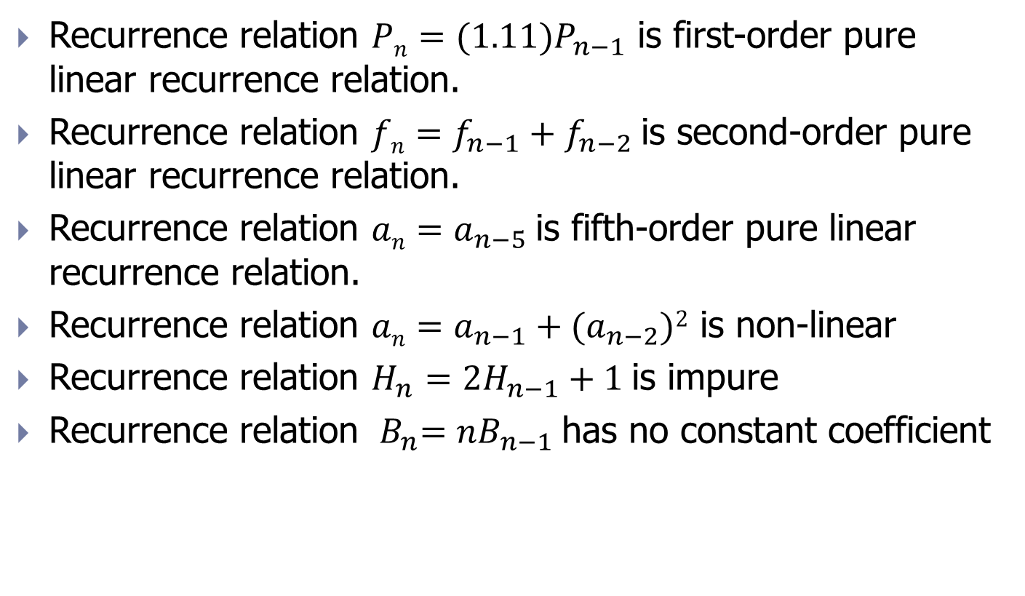
Example
Recurrence relation $Pn=(1.11)P_{n−1}$ is first-order pure linear recurrence relation.
Recurrence relation $fn=f_{n−1}+f_{n−2}$is second-order pure linear recurrence relation.
Recurrence relation $an=a_{n−5}$is fifth-order pure linear recurrence relation.
Recurrence relation $an=a_{n−1}+(a_{n−2})2$ is non-linear
Recurrence relation $H_{n}={2H}_{n−1}+1$is impure
Recurrence relation ${ B}_{n}=nB_{n−1}$has no constant coefficient

Slide 62



Solving method
The general method to solve pure recurrence relations is finding root in the form $an=rn$, in which $r$ is a constant. Note that, $an= rn$ is the root of recurrence relation if and only if:
$$r^{n}=c_{1}r^{n−1}+c_{2}r^{n−2}+…+c_{k}r^{n−k}$$
$$r^{k}−c_{1}r^{k−1}−c_{2}r^{k−2}−…−c_{k}=0$$
$$(3)$$
$$(4)$$
Charateristic equation

Slide 63
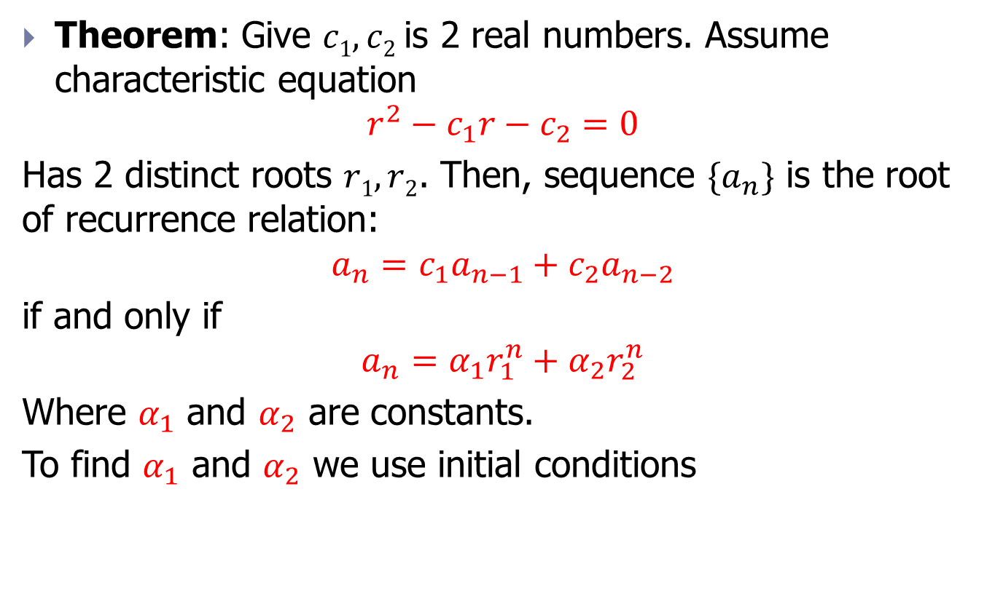
Case: distinct root
Theorem: Give $c1, c2$is 2 real numbers. Assume characteristic equation
$$r^{2}−c_{1}r−c_{2}=0$$
Has 2 distinct roots $r1, r2$. Then, sequence $\{a_{n}\}$ is the root of recurrence relation:
$$a_{n}=c_{1}a_{n−1}+c_{2}a_{n−2}$$
if and only if
$$a_{n}=α_{1}r_{1}^{n}+{α_{2}r}_{2}^{n}$$
Where $α_{1}$ and $α_{2}$ are constants.
To find $α_{1}$ and $α_{2}$ we use initial conditions

Slide 64

Example 21
Problem: Find root of recurrence relation
$$a_{n}=a_{n−1}+2a_{n−2}$$
with $a0=2, a1=7$.

Slide 65
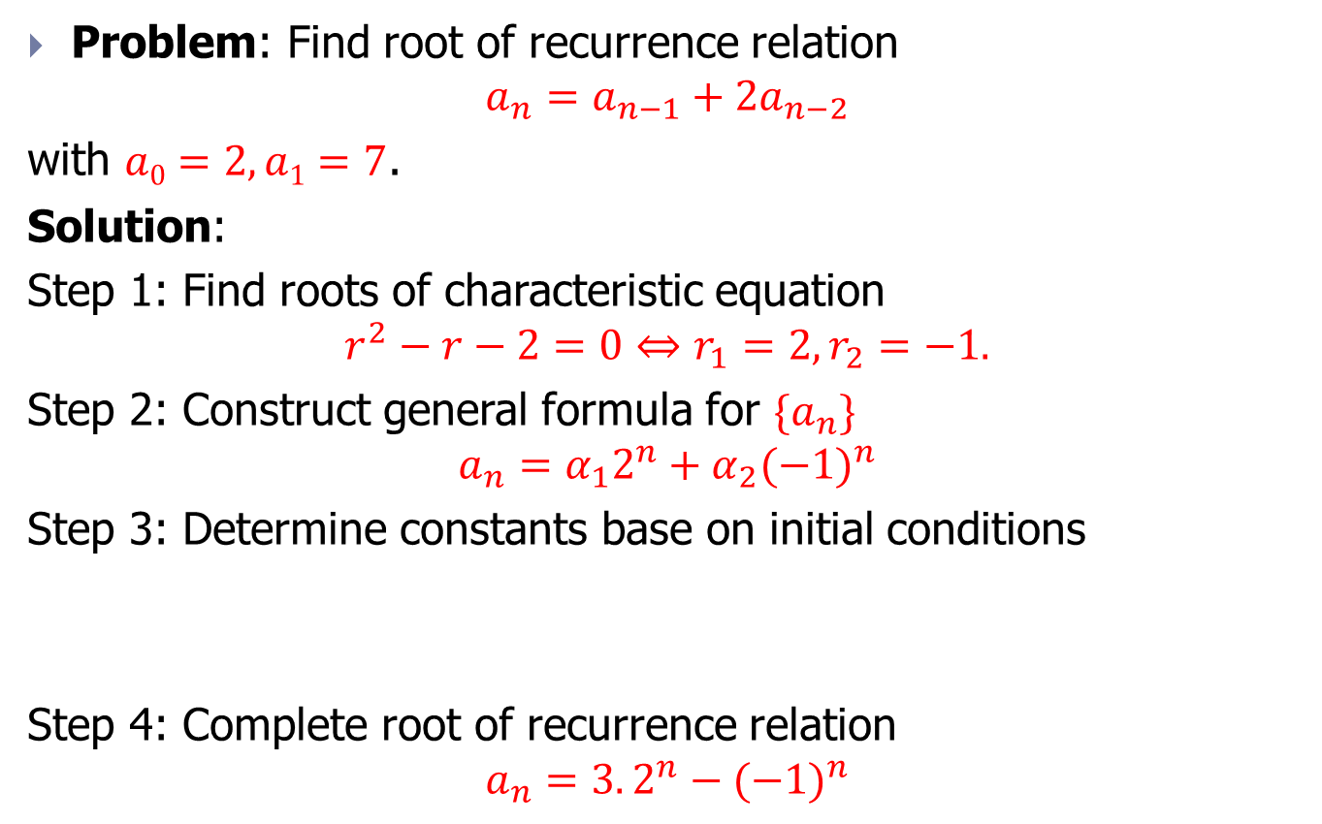
Example 21
Problem: Find root of recurrence relation
$$a_{n}=a_{n−1}+2a_{n−2}$$
with $a0=2, a1=7$.
Solution:
Step 1: Find roots of characteristic equation
$$r^{2}−r−2=0⇔r_{1}=2,r_{2}=−1.$$
Step 2: Construct general formula for ${\{a}_{n}\}$
$$a_{n}=α_{1}2^{n}+α_{2}{(−1)}^{n}$$
Step 3: Determine constants base on initial conditions
Step 4: Complete root of recurrence relation
$$a_{n}=3.2^{n}−{(−1)}^{n}$$

Slide 66

Exercise 1
Find root of recurrence relation $F_{n}=F_{n−1}+F_{n−2}$, $n≥2,$
with initial conditions $F_{0}=0,$ $F_{1}=1.$

Slide 67
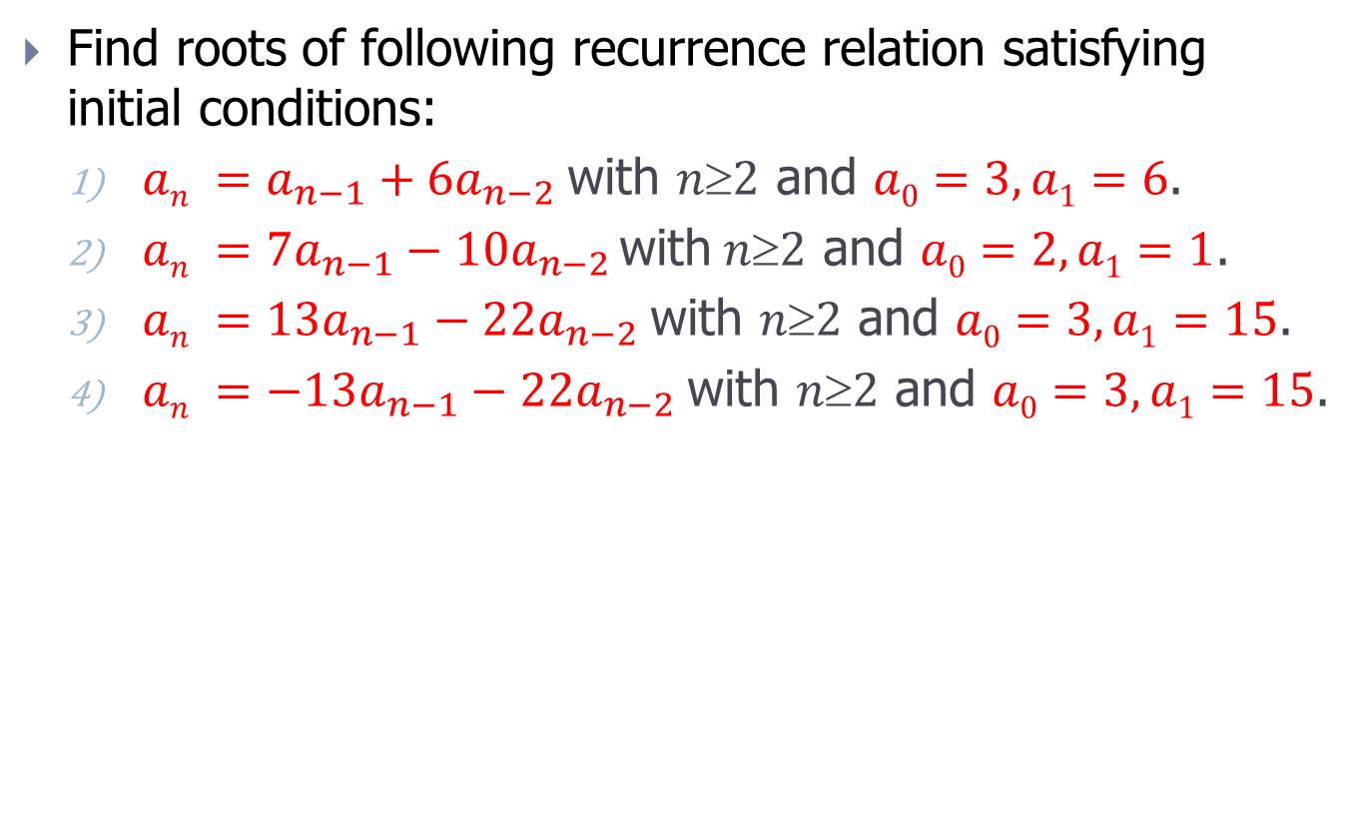
Exercise 2
Find roots of following recurrence relation satisfying initial conditions:
$an =a_{n−1}+6a_{n−2}$with $n2$ and $a0=3, a1=6$.
$an =7a_{n−1}−10a_{n−2 }\text{with} n≥2$ and $a0=2, a1=1$.
$an =13a_{n−1}−22a_{n−2} \text{with} n≥2$ and $a0=3, a1=15$.
$an =−13a_{n−1}−22a_{n−2} \text{with} n≥2$ and $a0=3, a1=15$.

Slide 68
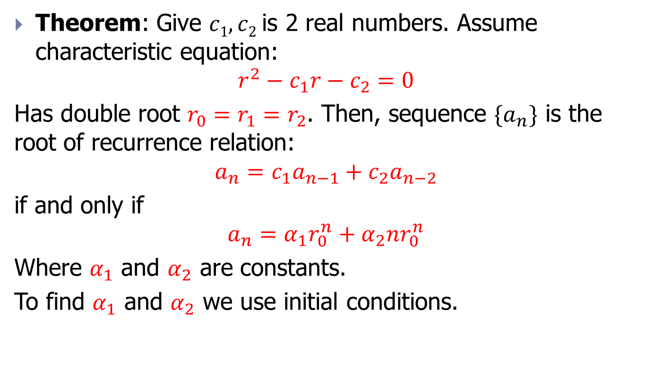
Case: double root
Theorem: Give $c1, c2$is 2 real numbers. Assume characteristic equation:
$$r^{2}−c_{1}r−c_{2}=0$$
Has double root $r_{0}=r_{1}=r_{2}$. Then, sequence $\{a_{n}\}$ is the root of recurrence relation:
$$a_{n}=c_{1}a_{n−1}+c_{2}a_{n−2}$$
if and only if
$$a_{n}=α_{1}r_{0}^{n}+{α_{2}nr}_{0}^{n}$$
Where $α_{1}$ and $α_{2}$ are constants.
To find $α_{1}$ and $α_{2}$ we use initial conditions.

Slide 69

Example 22
Problem: Find root of recurrence relation:
$$a_{n}={6a}_{n−1}−9a_{n−2}$$
with $a0=1, a1=6$.

Slide 70
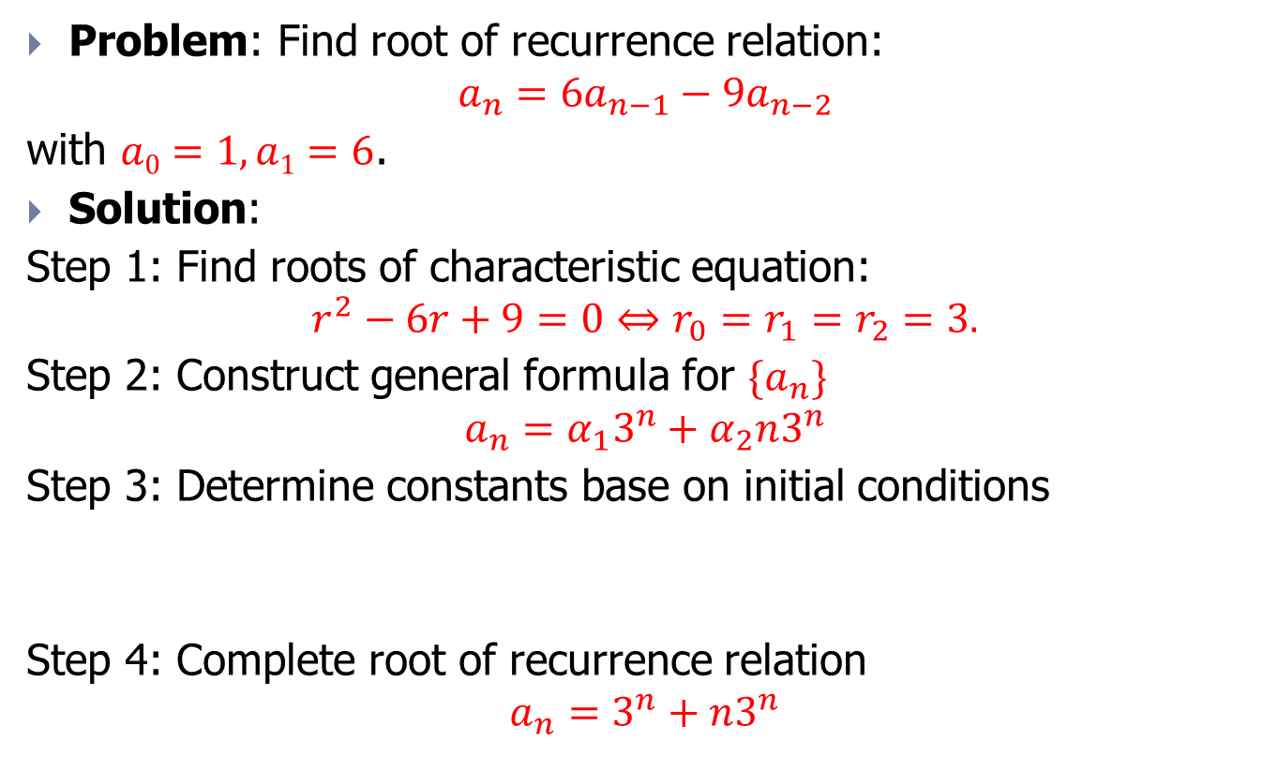
Example 22
Problem: Find root of recurrence relation:
$$a_{n}={6a}_{n−1}−9a_{n−2}$$
with $a0=1, a1=6$.
Solution:
Step 1: Find roots of characteristic equation:
$$r^{2}−6r+9=0⇔r_{0}=r_{1}=r_{2}=3.$$
Step 2: Construct general formula for ${\{a}_{n}\}$
$$a_{n}=α_{1}3^{n}+α_{2}n3^{n}$$
Step 3: Determine constants base on initial conditions
Step 4: Complete root of recurrence relation
$$a_{n}=3^{n}+n3^{n}$$

Slide 71
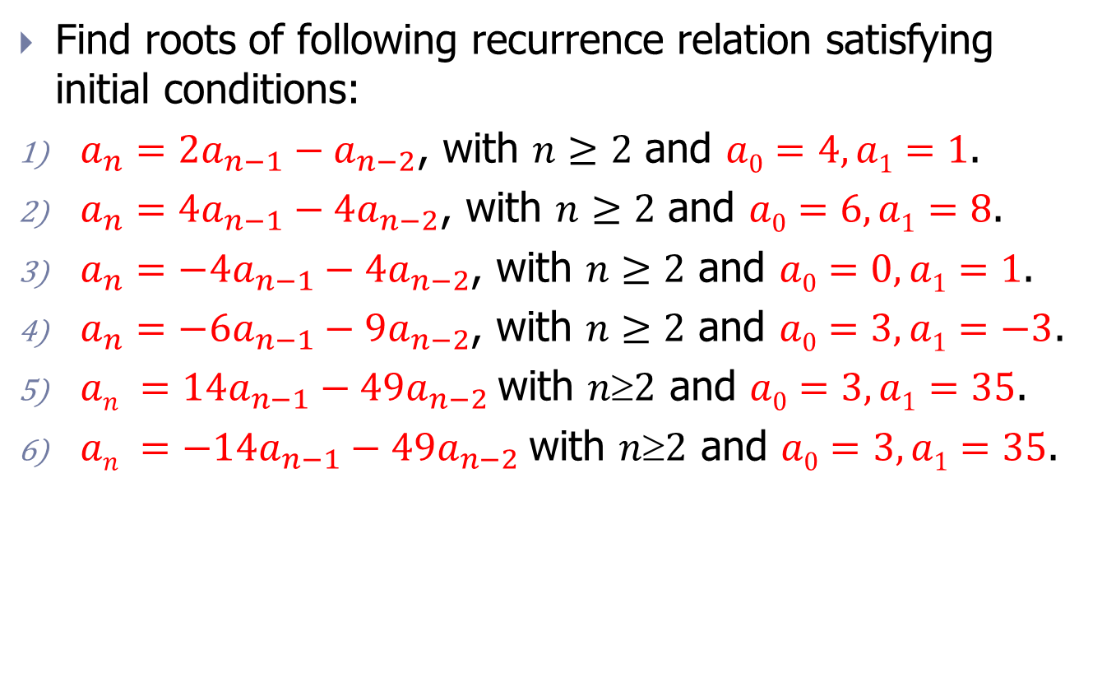
Exercise
Find roots of following recurrence relation satisfying initial conditions:
$a_{n}={2a}_{n−1}−a_{n−2}$, with $n≥2$ and $a0=4, a1=1$.
$a_{n}={4a}_{n−1}−{4a}_{n−2}$, with $n≥2$ and $a0=6, a1=8$.
$a_{n}={−4a}_{n−1}−{4a}_{n−2}$, with $n≥2$ and $a0=0, a1=1$.
$a_{n}={−6a}_{n−1}−{9a}_{n−2}$, with $n≥2$ and $a0=3,a1=−3$.
$an =14a_{n−1}−49a_{n−2}$with $n2$ and $a0=3, a1=35$.
$an =−14a_{n−1}−49a_{n−2}$with $n2$ and $a0=3, a1=35$.

Slide 72
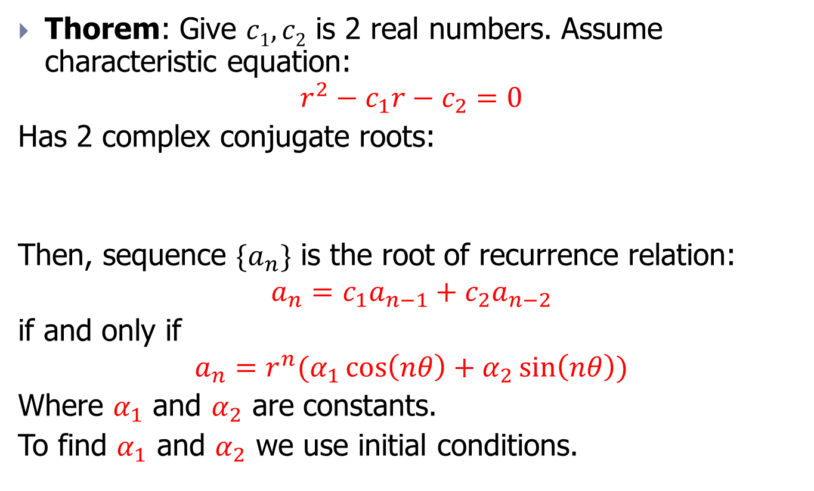
Case: root is complex numbers
Thorem: Give $c1, c2$ is 2 real numbers. Assume characteristic equation:
$$r^{2}−c_{1}r−c_{2}=0$$
Has 2 complex conjugate roots:
Then, sequence $\{a_{n}\}$ is the root of recurrence relation:
$$a_{n}=c_{1}a_{n−1}+c_{2}a_{n−2}$$
if and only if
$$a_{n}=r^{n}(α_{1}\cos\left(nθ\right)+α_{2}\sin\left(nθ\right))$$
Where $α_{1}$ and $α_{2}$ are constants.
To find $α_{1}$ and $α_{2}$ we use initial conditions.

Slide 73

Example 23
Problem: Find roots of recurrence relation:
$$a_{n}={2a}_{n−1}−4a_{n−2}$$
with $a1=4, a2=4$.

Slide 74

Example 23
Step 1: Find the roots of characteristic equation:
$$r^{2}−2r+4=0⇔\left\{\begin{aligned}r_{1}=2(\cos\left(\frac{π}{3}\right)+isin\left(\frac{π}{3}\right)) \\ r_{2}=2(\cos\left(\frac{π}{3}\right)−isin\left(\frac{π}{3}\right))\end{aligned}\right.$$
Step 2: Construct general formula for ${\{a}_{n}\}$
$$a_{n}=2^{n}(α_{1}\cos\left(n\frac{π}{3}\right)+α_{2}\sin\left(n\frac{π}{3}\right))$$
Step 3: Determine constants base on initial conditions
Step 4: Complete root of recurrence relation
$$a_{n}=2^{n}(\cos\left(n\frac{π}{3}\right)+\sqrt{3}\sin\left(n\frac{π}{3}\right))$$

Slide 75

General case
Theorem: Give $c1, c2 , …, ck$ are real numbers. Assume là các số thực. Giả sử characteristic equation:
$$r^{k}−c_{1}r^{k−1}−…−c_{k−1}r−c_{k}=0$$
has $k$ distinct roots $r1, r2, …, rk$.
Then, sequence $\{a_{n}\}$ is the root of recurrence relation:
$$a_{n}=c_{1}a_{n−1}+c_{2}a_{n−2}+…+c_{k}a_{n−k}$$
if and only if
$$a_{n}=α_{1}r_{1}^{n}+{α_{2}r}_{2}^{n}+…+{α_{k}r}_{k}^{n}$$
Where $α_{1}$,…,$α_{k}$ are constants.
To find $α_{1}$,…,$α_{k}$ we use initial conditions.

Slide 76

Exercise
Find the root of following recurrence relations with initial condition:
$a_{n}={6a}_{n−1}−{11a}_{n−2}+{6a}_{n−3}$, with $n≥3$ and $a0=2, a1=5, a2=15$.
$a_{n}={2a}_{n−1}+a_{n−2}−{2a}_{n−3}$, with $n≥3$ and $a0=3, a1=6, a2=0$.
$a_{n}={7a}_{n−2}+{6a}_{n−3}$, with $n≥3$ and $a0=9, a1=10, a2=32$.
$a_{n}={2a}_{n−1}+{5a}_{n−2}−{6a}_{n−3}$, with $n≥3$ and $a0=7, a1=−4, a2=8$.

Slide 77
Contents
Introduction
Basic counting principle
Conquer the the subproblem
Recurrence relations
Generating function method
Exercise

Slide 78

Definition and example
Definition: Generation function $g(x)$ of sequence numbers ${\{h_{n}\}}_{n=0,1,2,…}$ is an infinite sequence
$$g\left(x\right)=h_{0}+h_{1}x+h_{2}x^{2}+…=\sum_{i=0}^{+∞}{h_{i}}x^{i}$$
The function $g(x)$ generate the given sequence of numbers and its coefficients
Note: In case the sequence of numbers is finite, we will turn it into an infinite sequence by adding elements 0.
Example: The function $g\left(x\right)={(1+x)}^{n}$ generates a sequence of combinatorial coefficients
$${(1+x)}^{n}=\sum_{k=0}^{n}{C_{n}^{k}x^{k}}$$

Slide 79

Some common expansions
$\frac{x^{k}}{1−x}=x^{k}\left(1+x+x^{2}+…\right)=x^{k}+x^{k+1}+x^{k+2}+…$
$\frac{1−x^{k+1}}{1−x}=1+x+x^{2}+…+x^{k}.$
$\frac{1}{1−x^{2}}=1+x^{2}+x^{4}+x^{6}+…$
$\frac{x}{1−x^{2}}=x\left(1+x^{2}+x^{4}+x^{6}+…\right)=x+x^{3}+x^{5}+x^{7}+…$

Slide 80
Contents
Introduction
Basic counting principle
Conquer the the subproblem
Recurrence relations
Generating function method
Exercise

Slide 81

Example 24
Problem: Construct a generator function to solve the following problem: How many ways are there to choose $n$ fruits from 4 types: apple, banana, orange, peach; in which there are an even number of apples, an odd number of bananas, no more than 4 oranges and at least 2 peaches?

Slide 82

Example 24
Problem: Construct a generator function to solve the following problem: How many ways are there to choose $n$ fruits from 4 types: apple, banana, orange, peach; in which there are an even number of apples, an odd number of bananas, no more than 4 oranges and at least 2 peaches?
Hint: Generator function for this problem:
$$(1+x^{2}+x^{4}+x^{6}+…)(x+x^{3}+x^{5}+…)(1+x+x^{2}+x^{3}+x^{4})(x^{2}+x^{3}+x^{4}+…)$$
Or $g\left(x\right)=\left[\frac{1}{1−x^{2}}\right]\left[\frac{x}{1−x^{2}}\right]\left[\frac{1−x^{5}}{1−x}\right]\left[\frac{x^{2}}{1−x}\right]$
The number of ways to choose fruit is the coefficient of $x^{n}$ in the expansion (triển khai) of $g\left(x\right)$ based on a power sequence

Slide 83

Example 24
Problem: Construct a generator function to solve the following problem: How many ways are there to choose $n$ fruits from 4 types: apple, banana, orange, peach; in which there are an even number of apples, an odd number of bananas, no more than 4 oranges and at least 2 peaches?
Hint: Generator function for this problem:
$$(1+x^{2}+x^{4}+x^{6}+…)(x+x^{3}+x^{5}+…)(1+x+x^{2}+x^{3}+x^{4})(x^{2}+x^{3}+x^{4}+…)$$
Or $g\left(x\right)=\left[\frac{1}{1−x^{2}}\right]\left[\frac{x}{1−x^{2}}\right]\left[\frac{1−x^{5}}{1−x}\right]\left[\frac{x^{2}}{1−x}\right]$
The number of ways to choose fruit is the coefficient of $x^{n}$ in the expansion (triển khai) of $g\left(x\right)$ based on a power sequence
Calculating the answer requires a lot of calculations, but can be solved on a computer easily!

Slide 84
Exercise 1
Find the generation function for the number of ways to exchange M (VND) using different types of money: 1000 VND, 5000 VND, 10000 VND, 50000 VND (assume that we have an unlimited number of each type of money)

